Slide 1
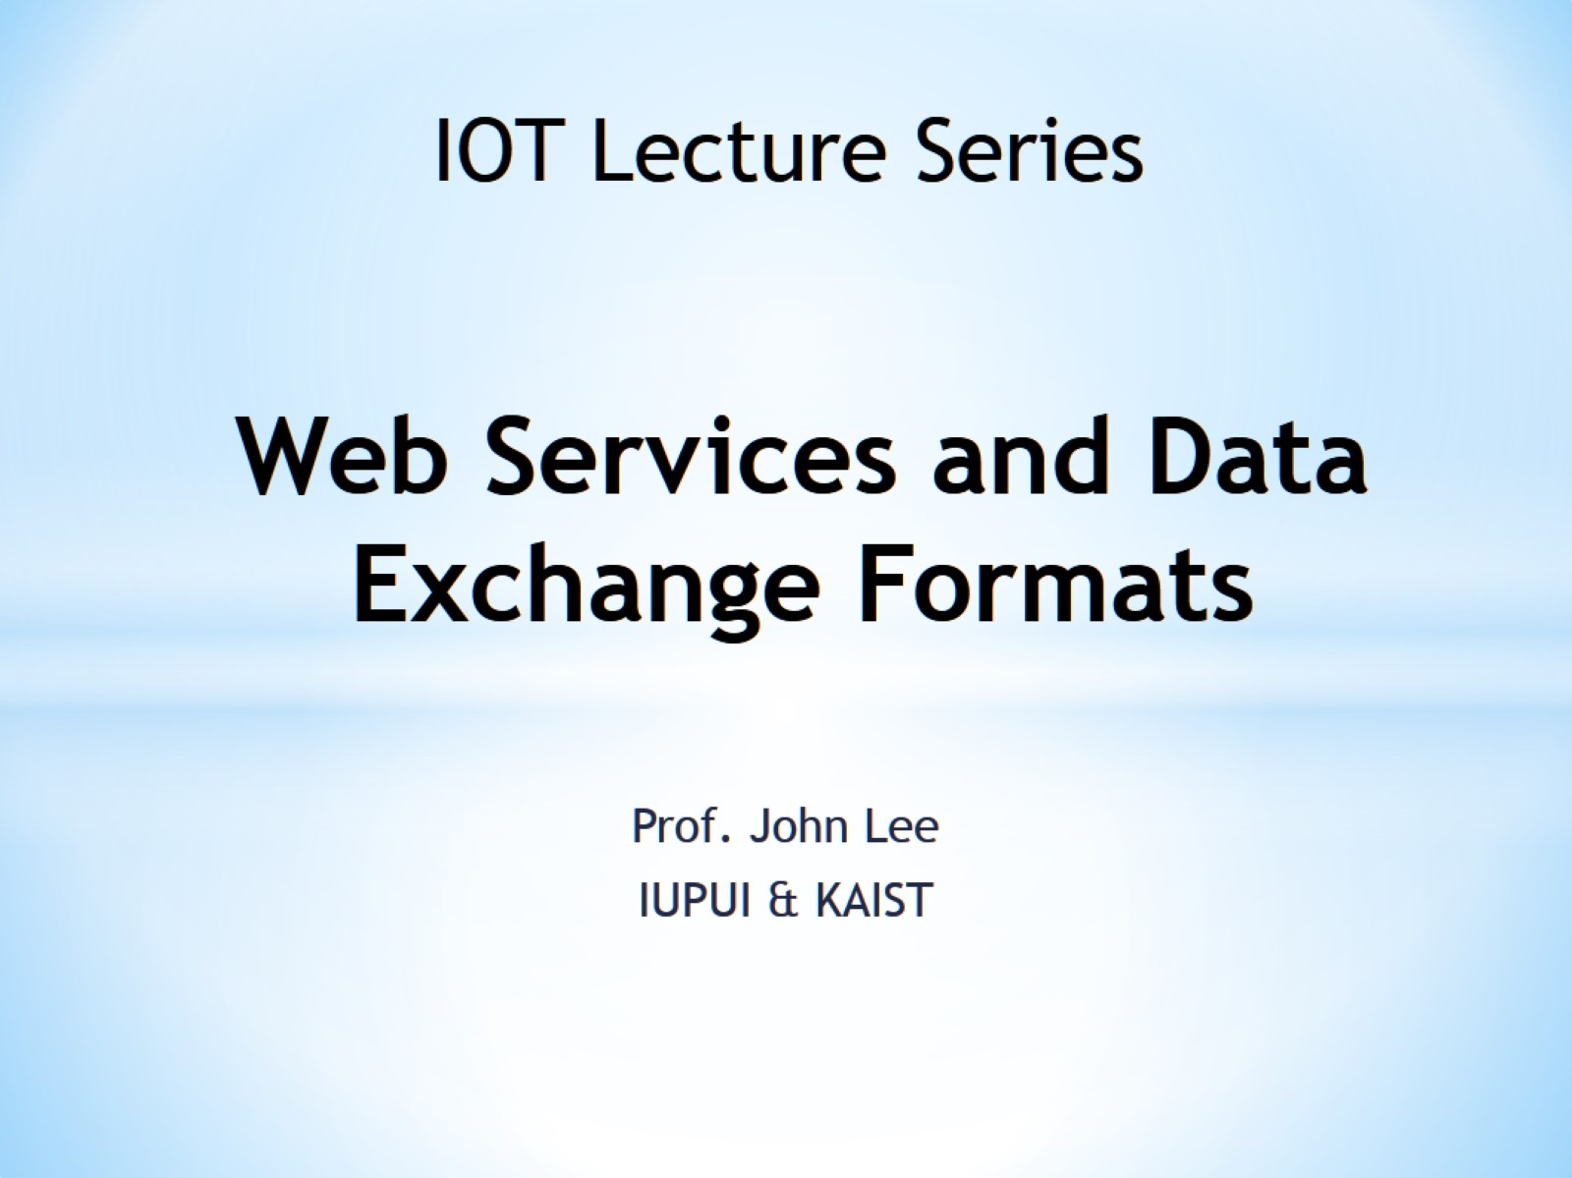
Web Services and Data Exchange Formats

Slide 2
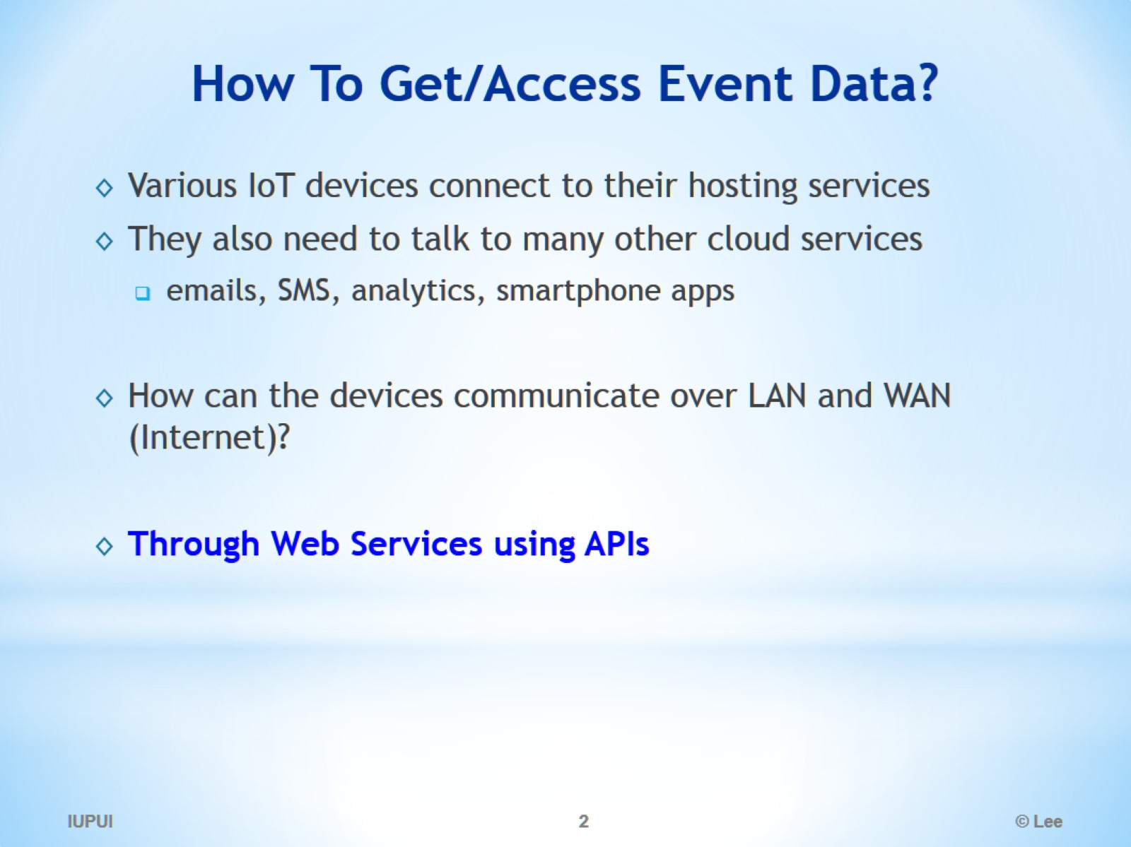
How To Get/Access Event Data?

Slide 3
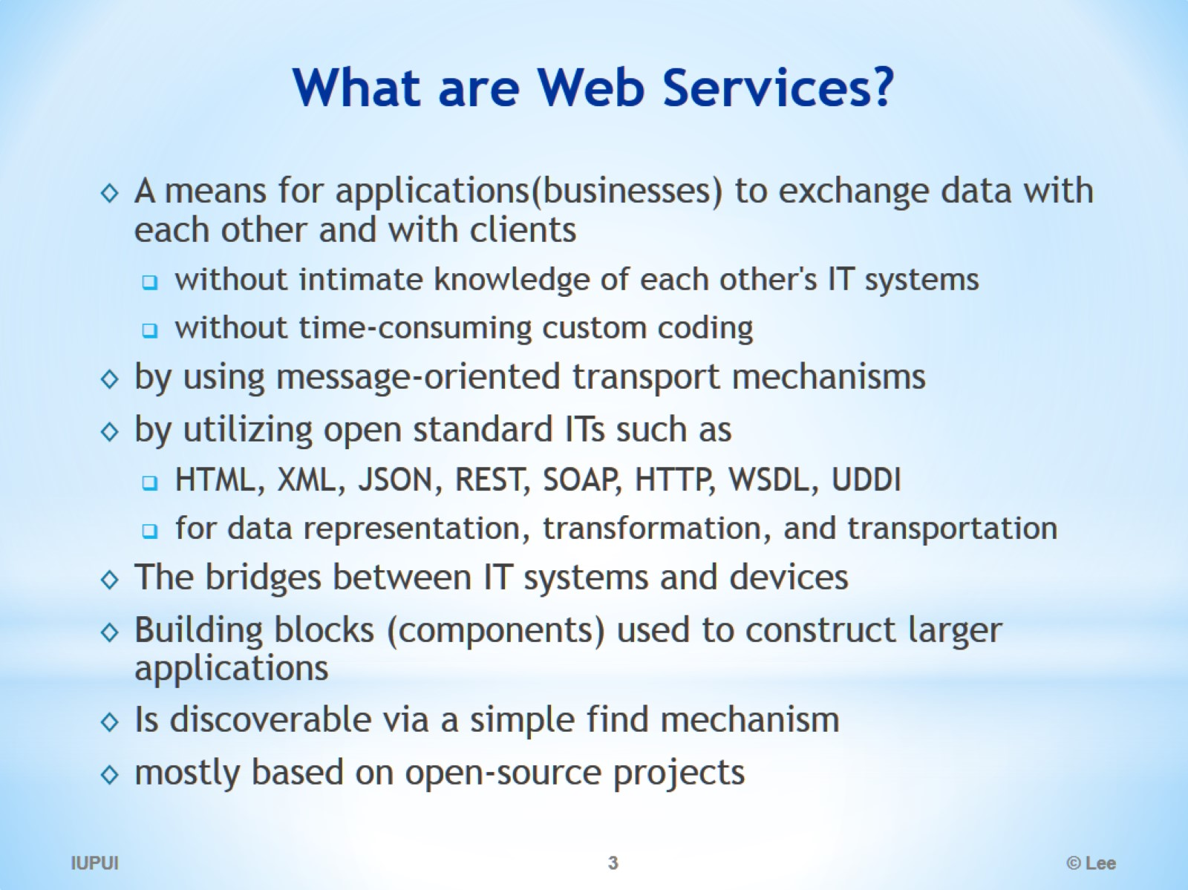
What are Web Services?

Slide 4
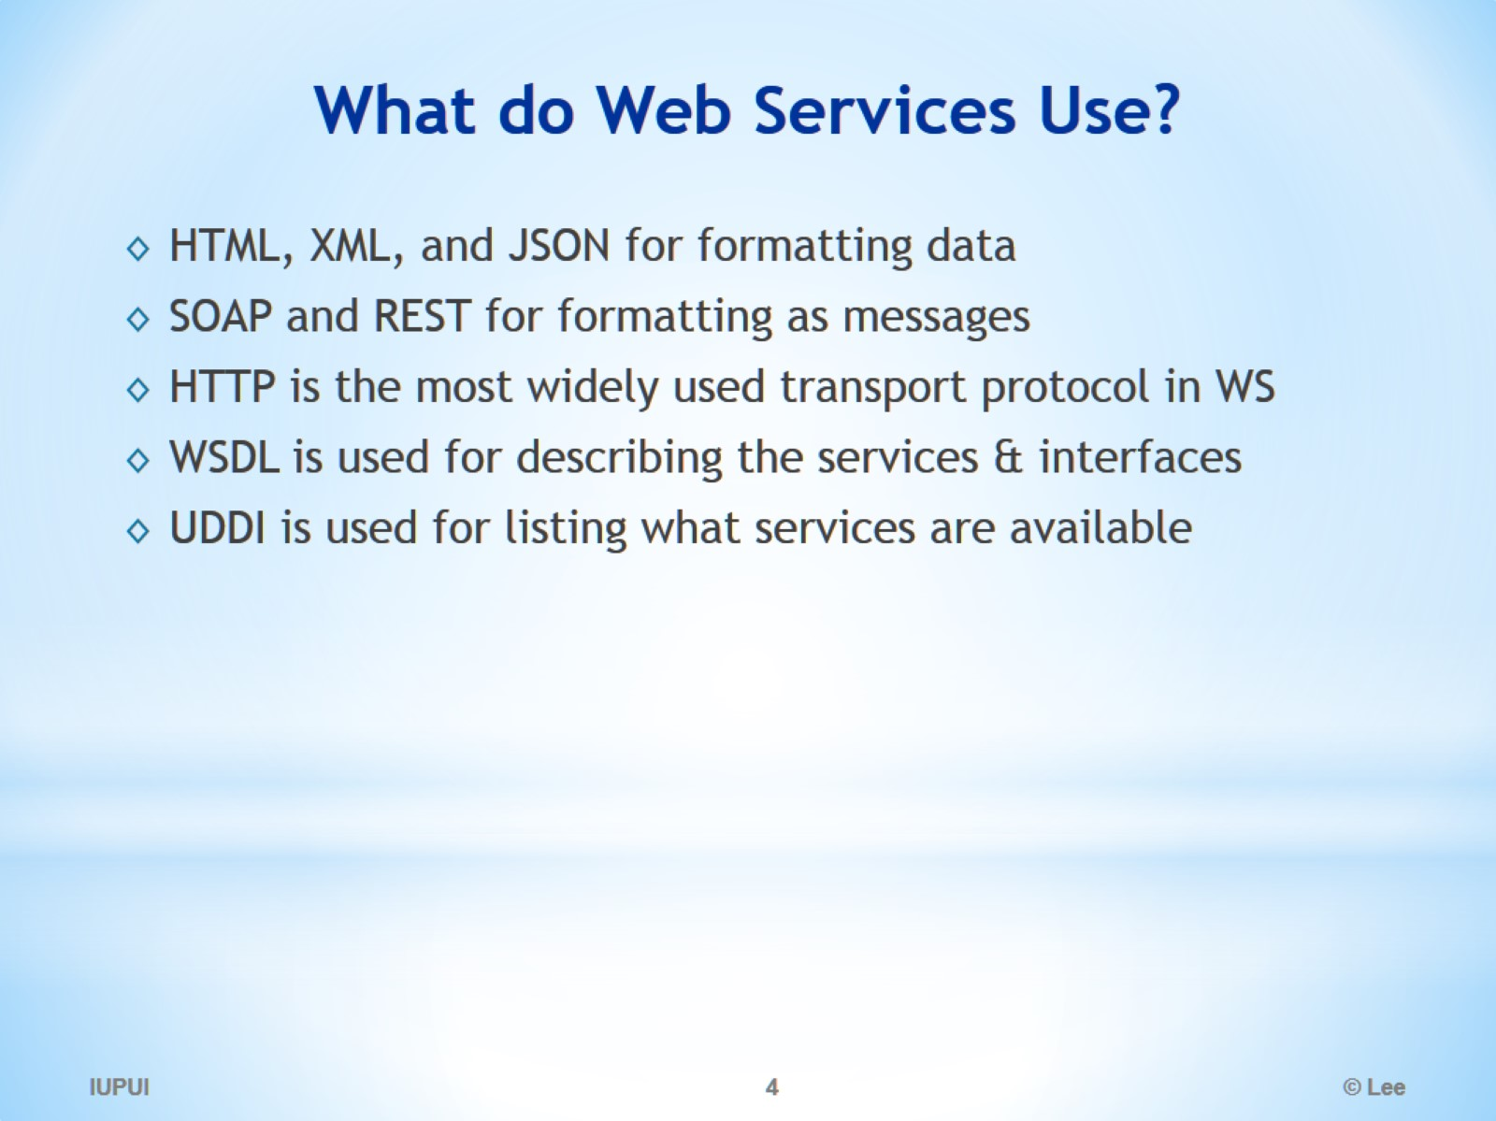
What do Web Services Use?

Slide 5
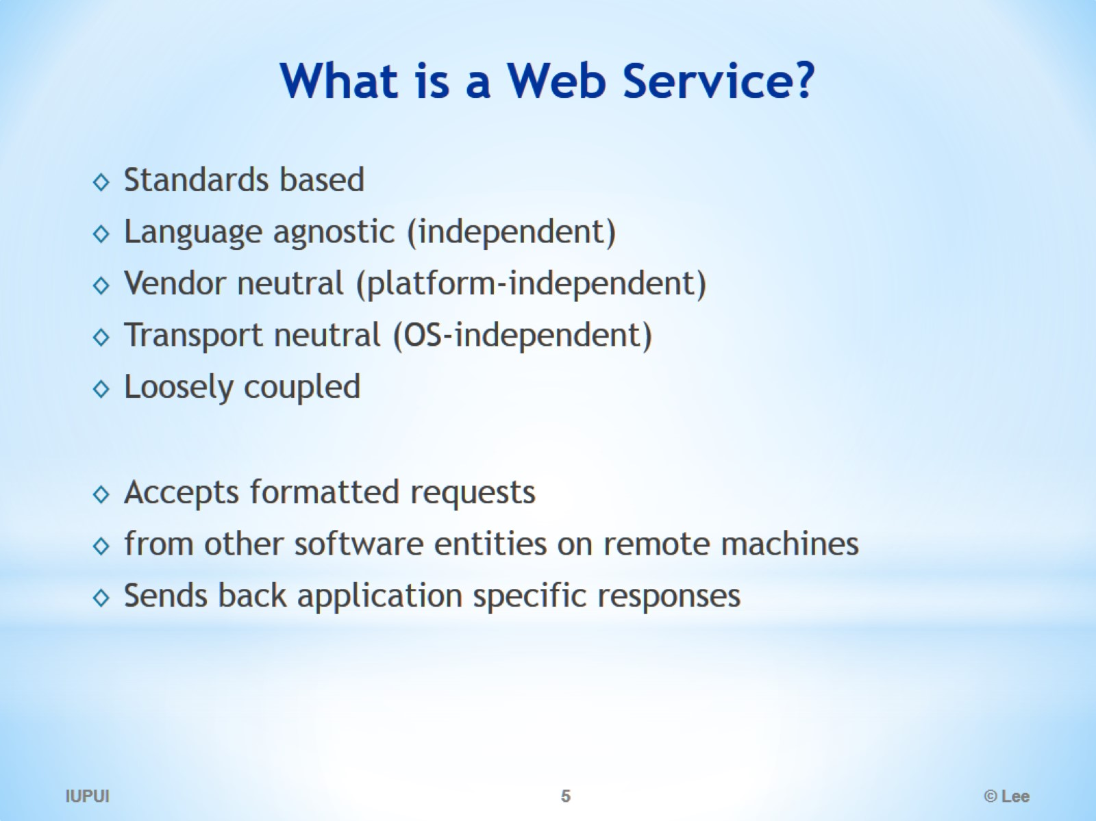
What is a Web Service?

Slide 6
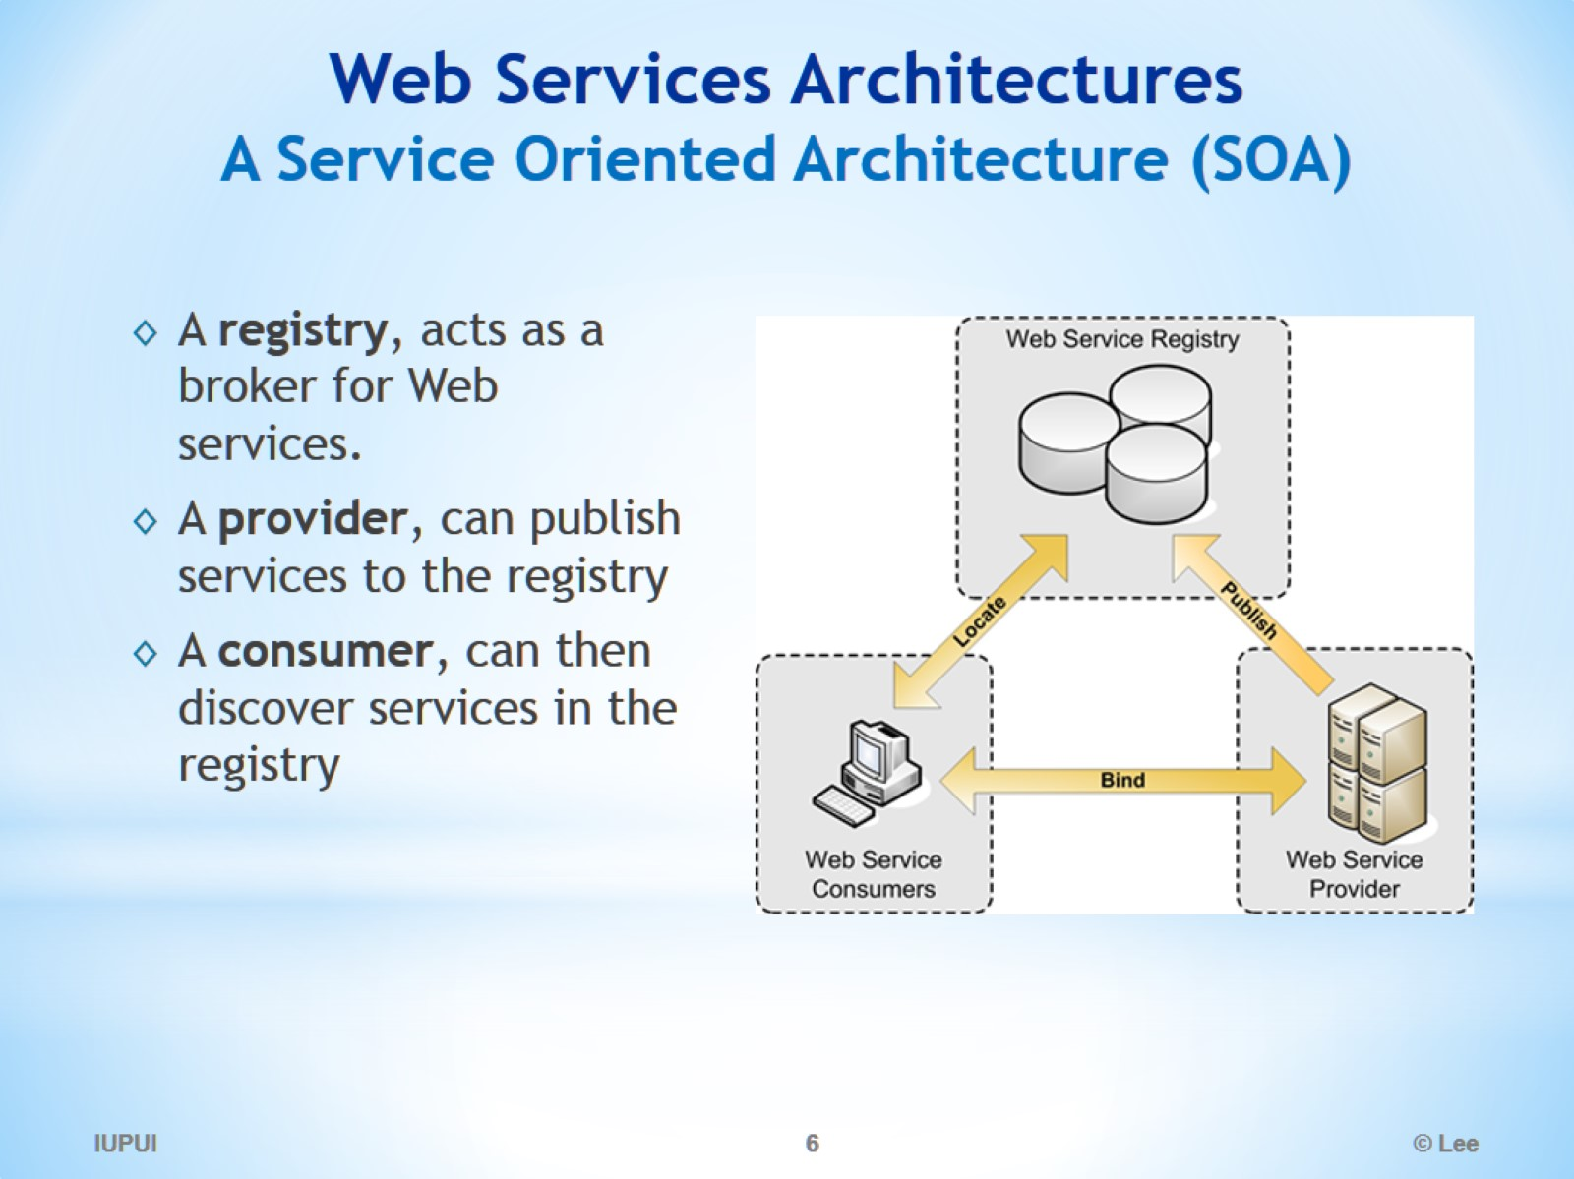
Web Services Architectures A Service Oriented Architecture (SOA)

Slide 7
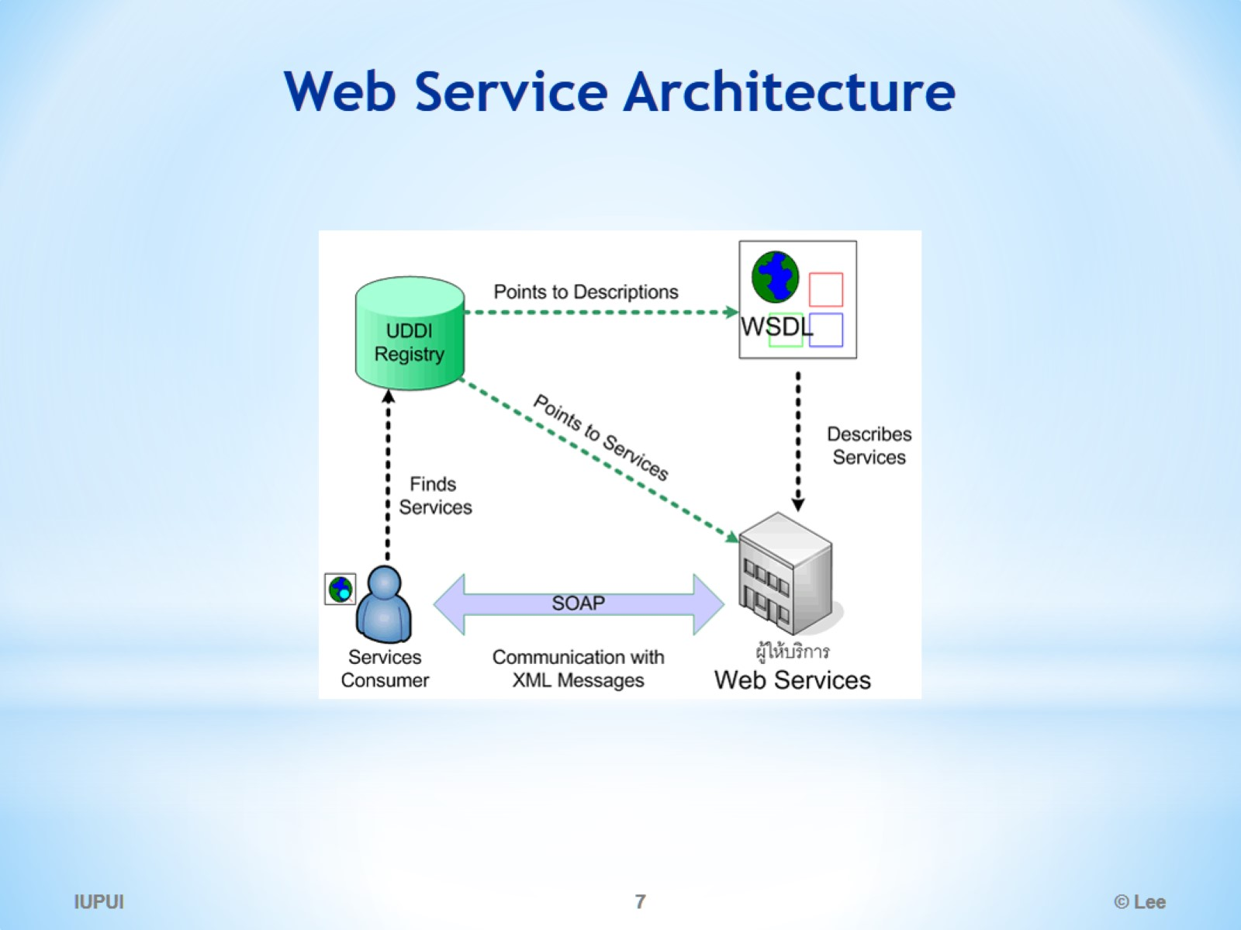
Web Service Architecture

Slide 8
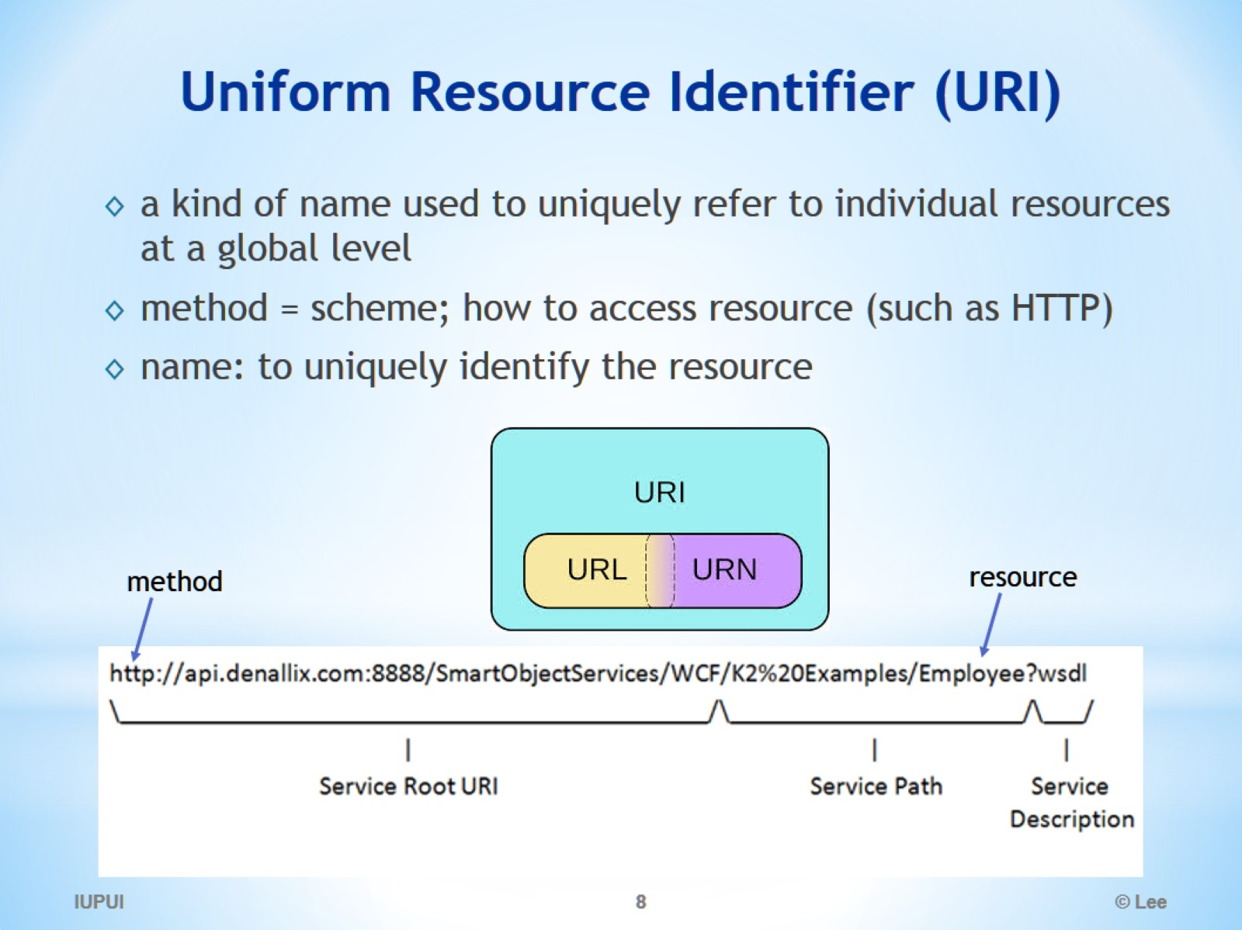
Uniform Resource Identifier (URI)

Slide 9
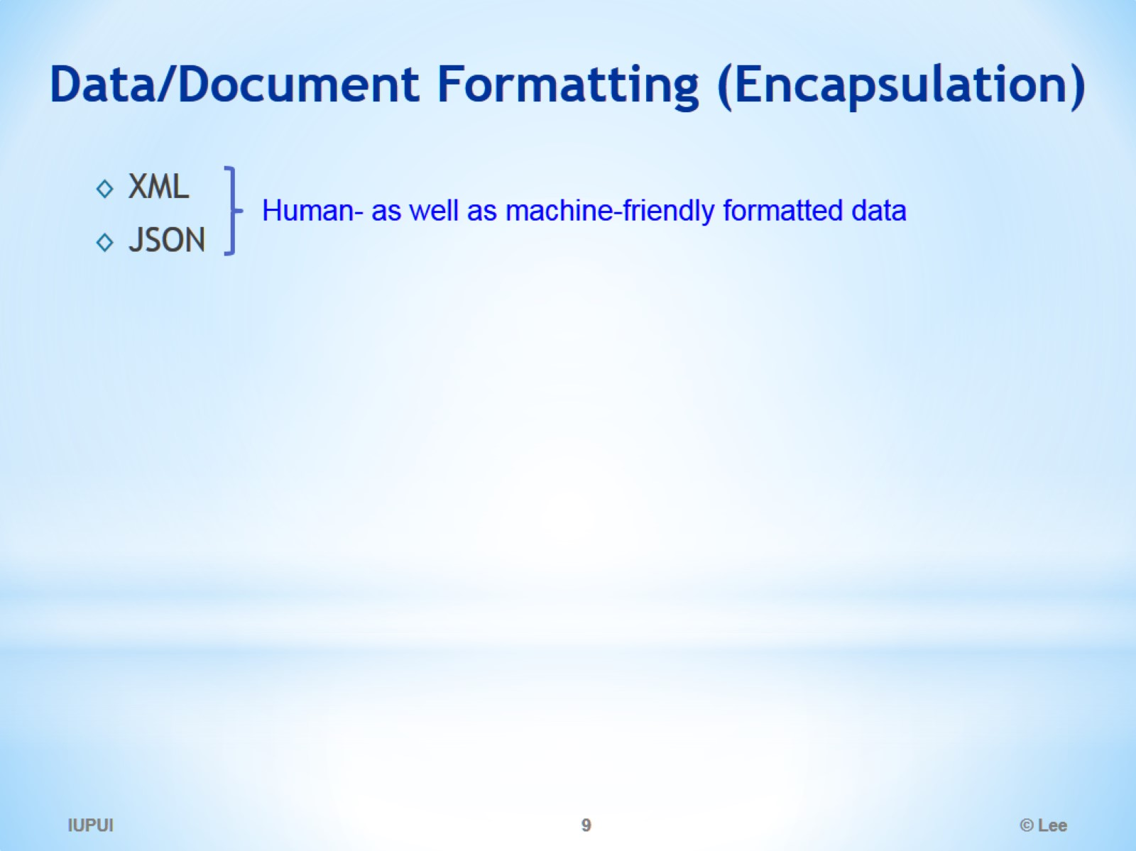
Data/Document Formatting (Encapsulation)

Slide 10
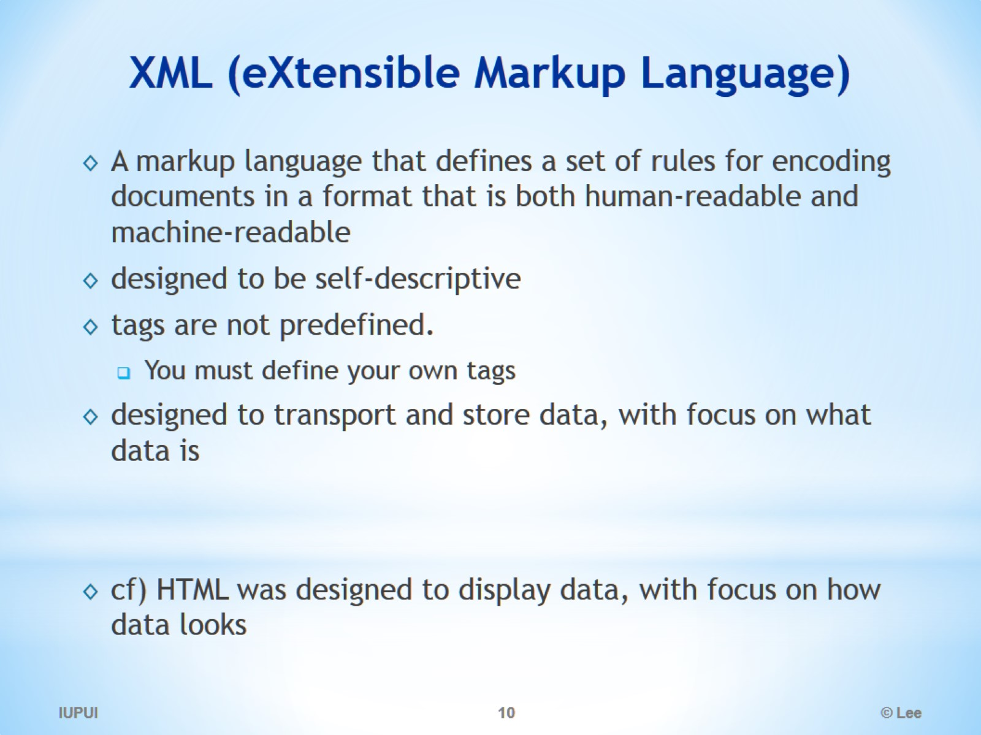
XML (eXtensible Markup Language)

Slide 11
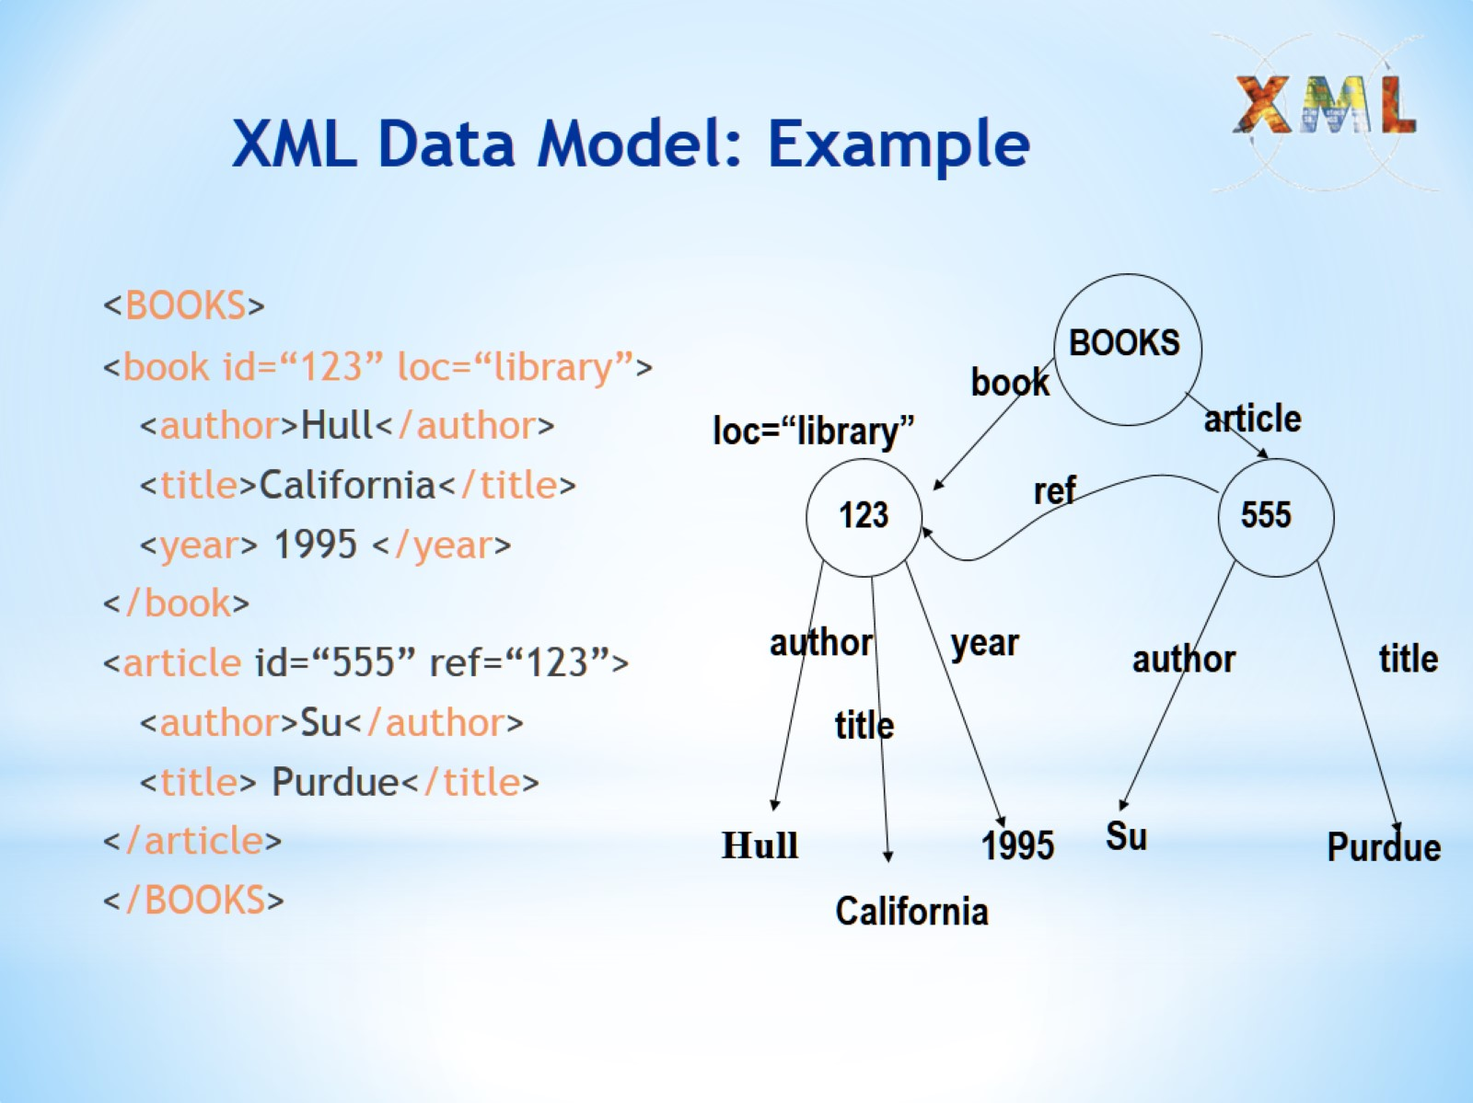
XML Data Model: Example

Slide 12
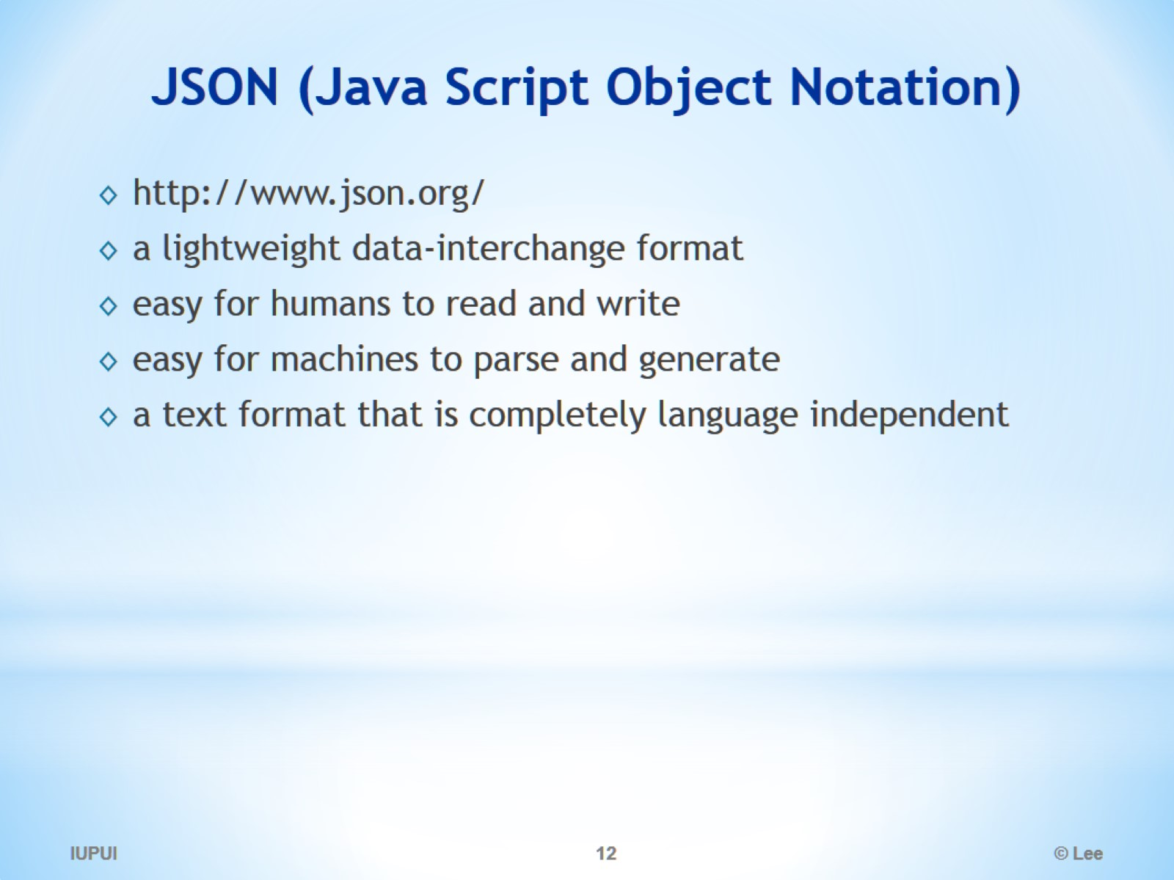
JSON (Java Script Object Notation)

Slide 13
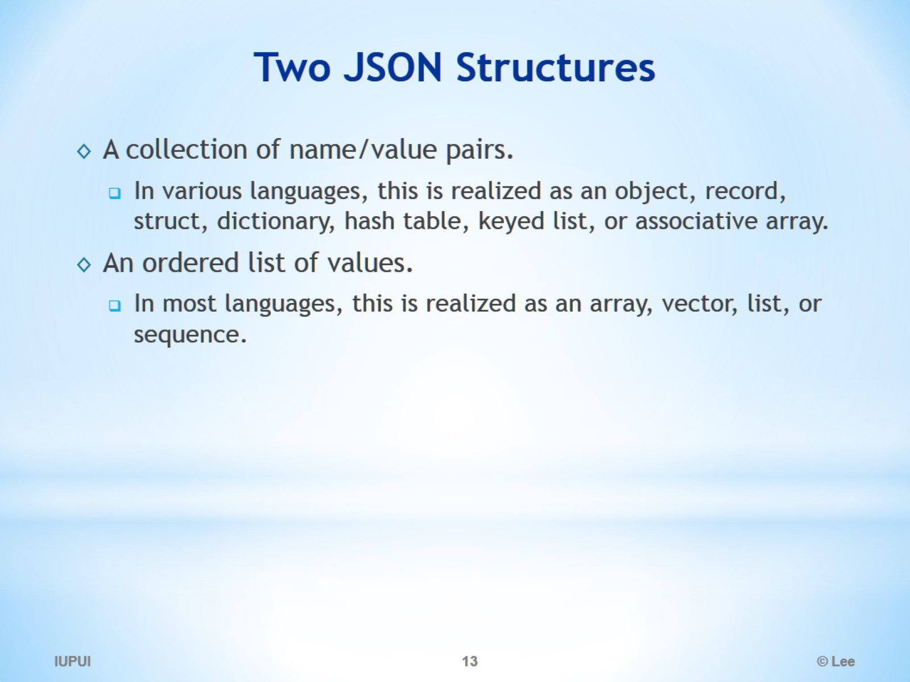
Two JSON Structures

Slide 14
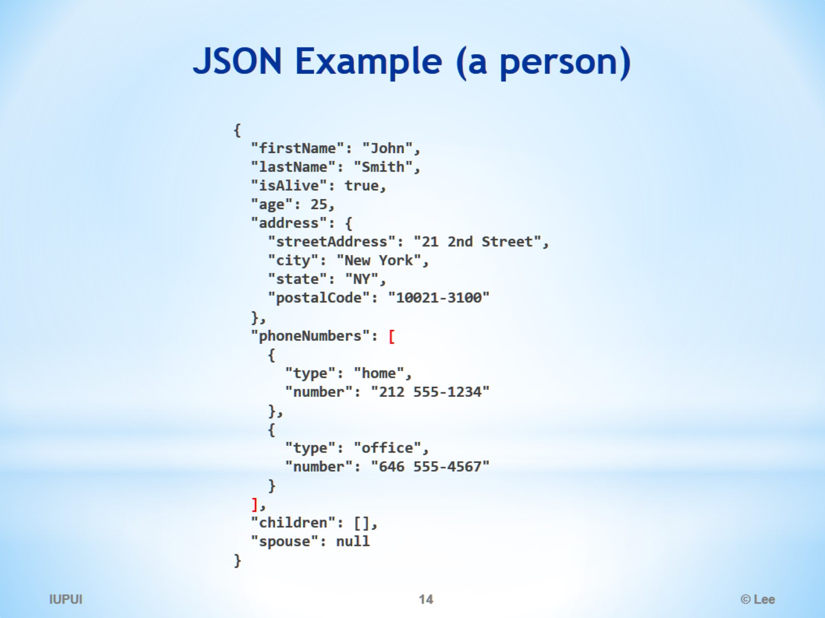
JSON Example (a person)

Slide 15
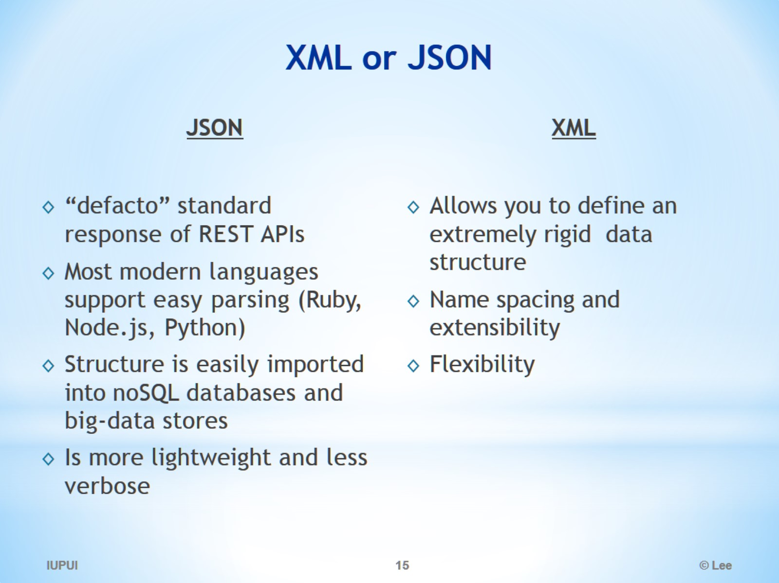
XML or JSON

Slide 16
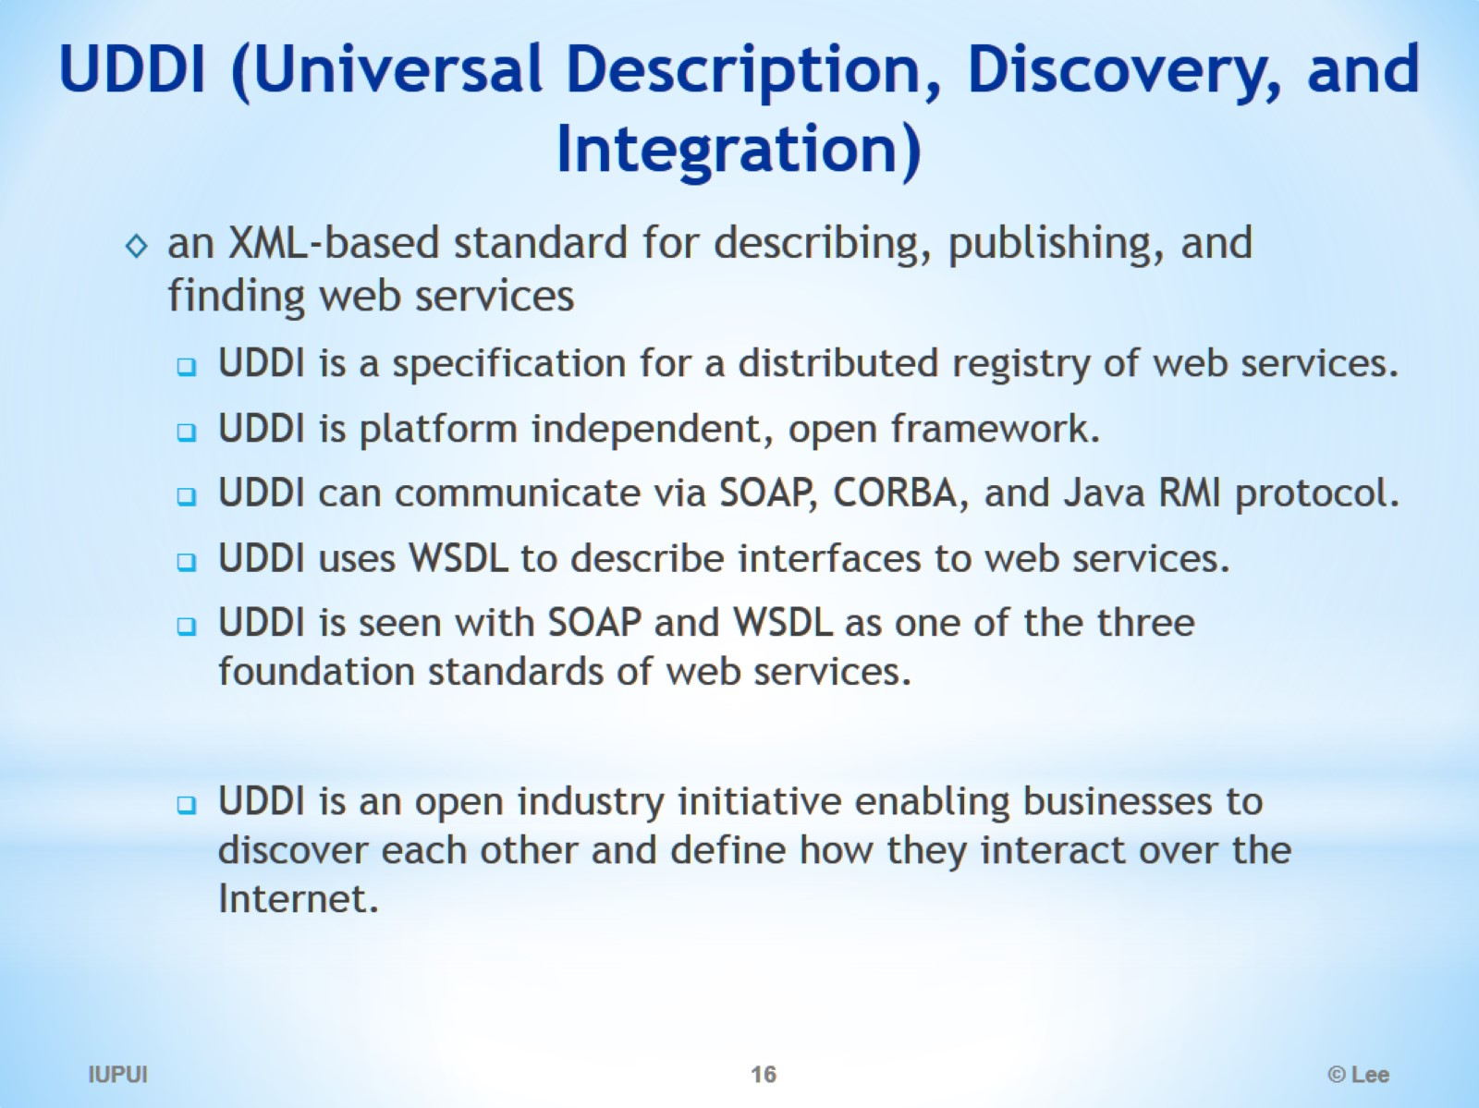
UDDI (Universal Description, Discovery, and Integration)

Slide 17
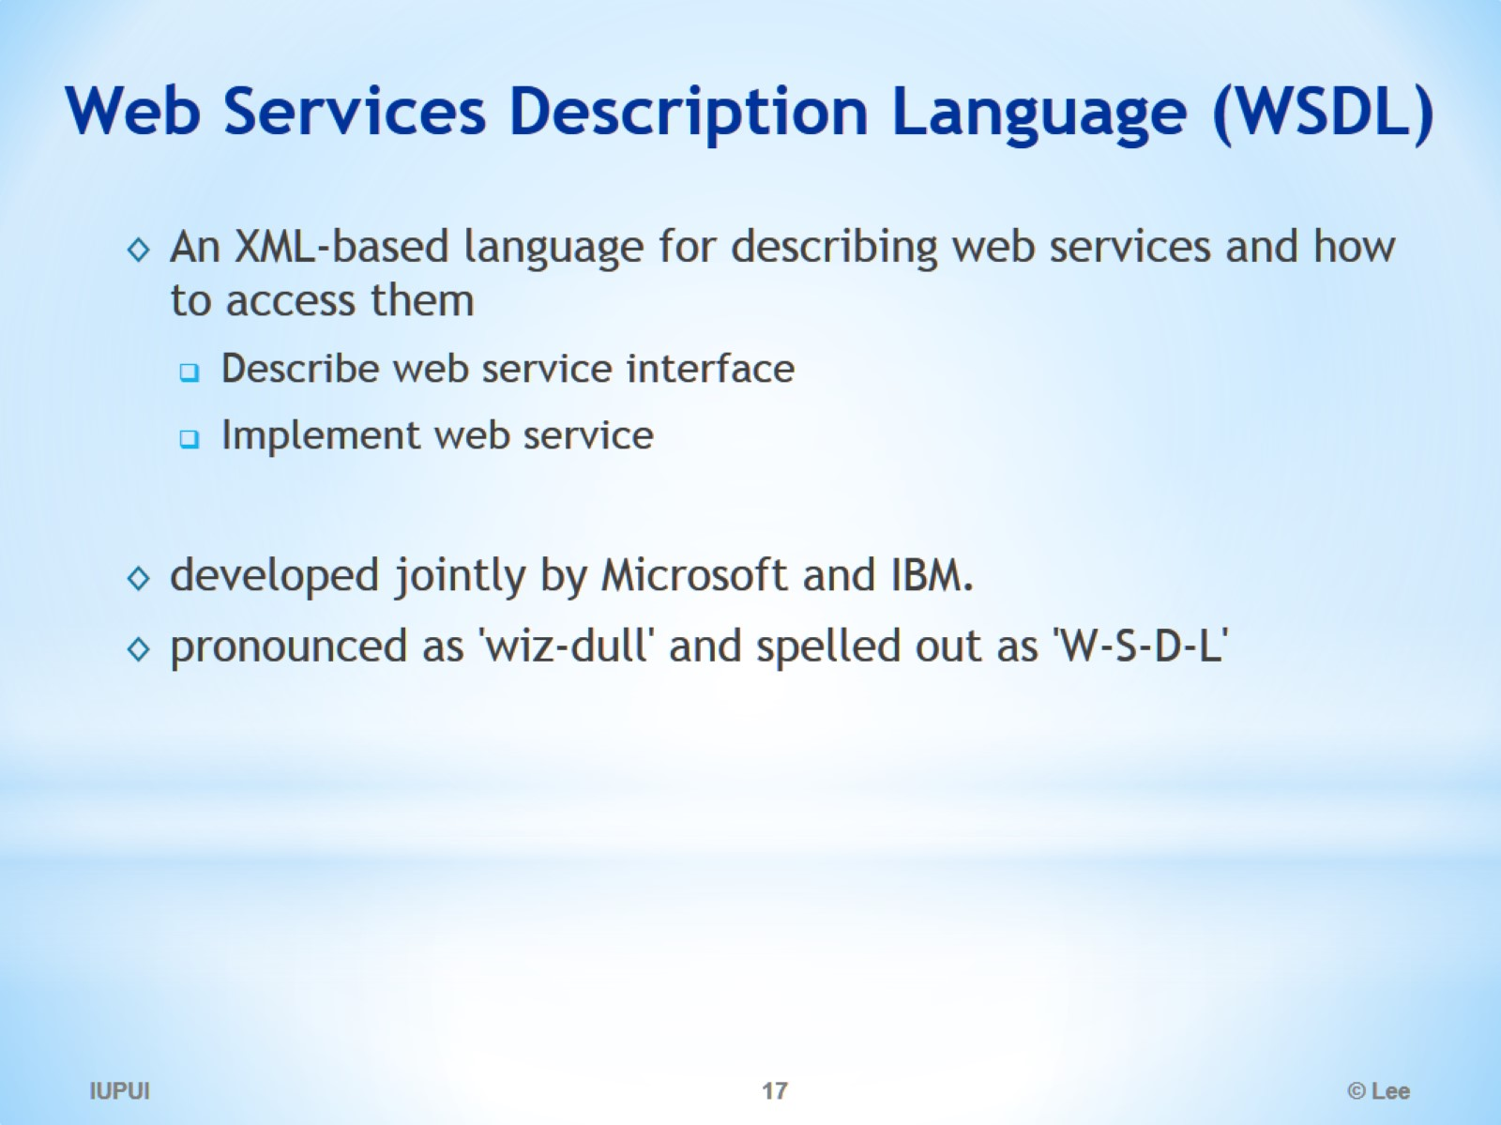
Web Services Description Language (WSDL)

Slide 18
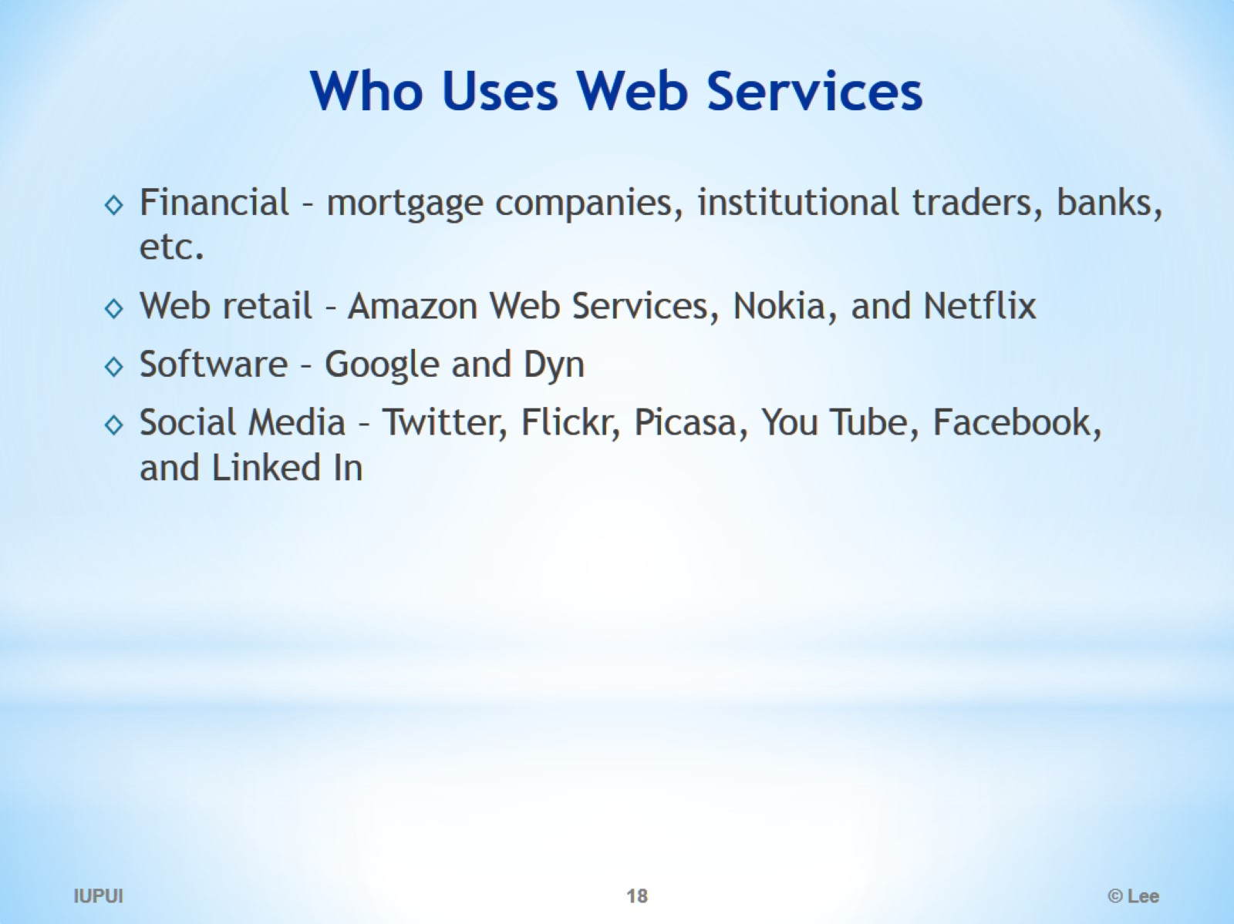
Who Uses Web Services

Slide 19
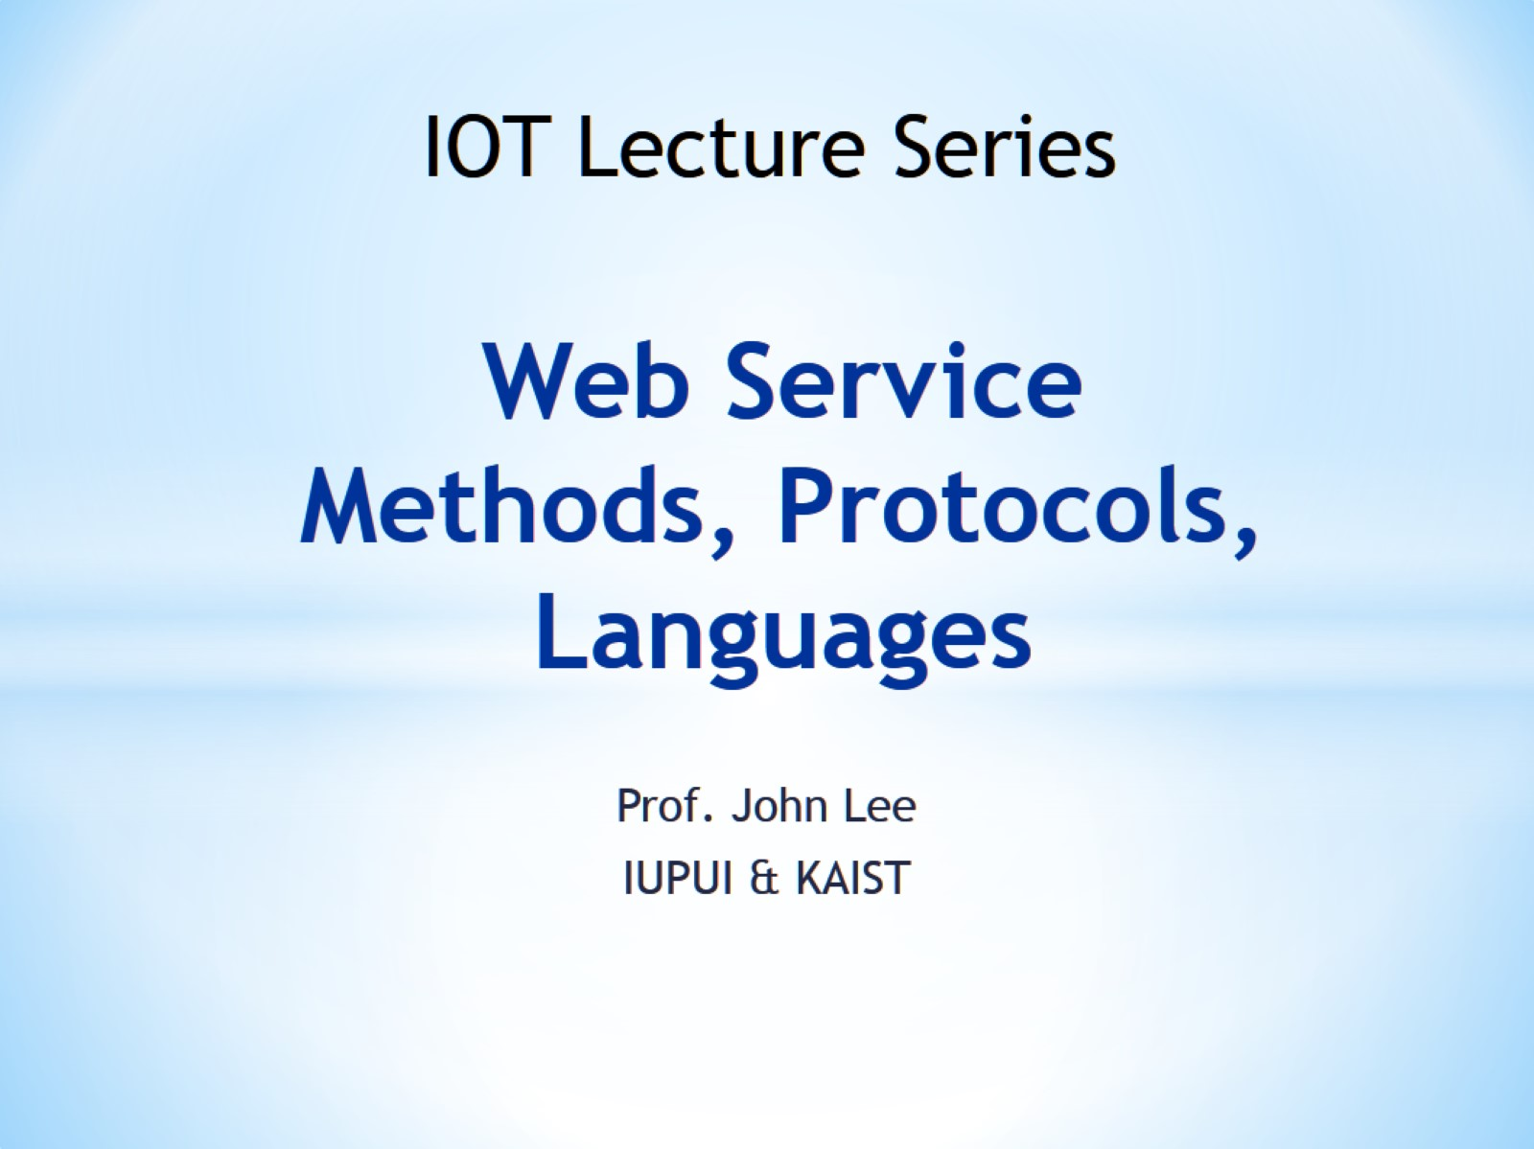
Web Service Methods, Protocols, Languages

Slide 20
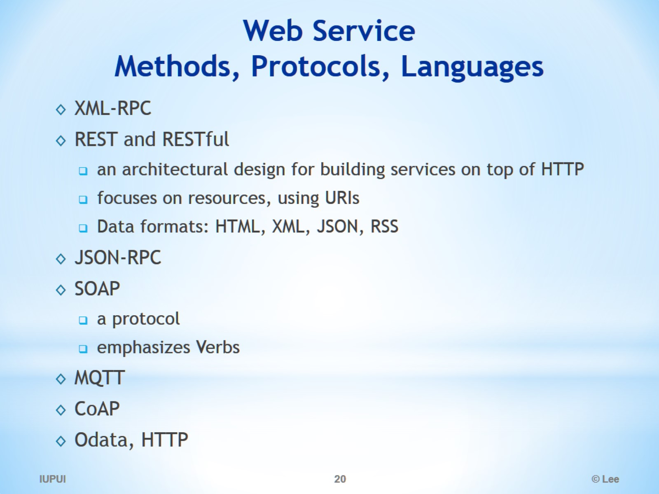
Web Service Methods, Protocols, Languages

Slide 21
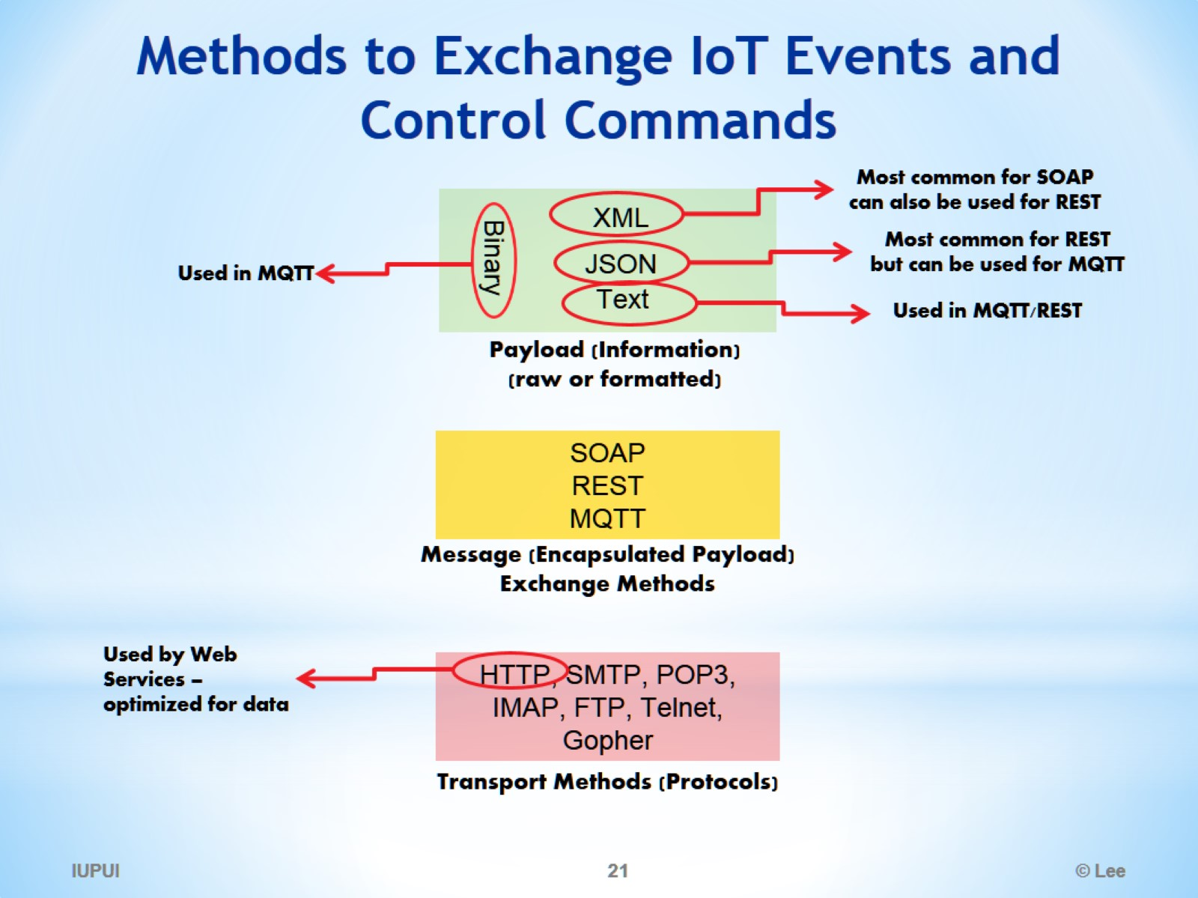
Methods to Exchange IoT Events and Control Commands

Slide 22
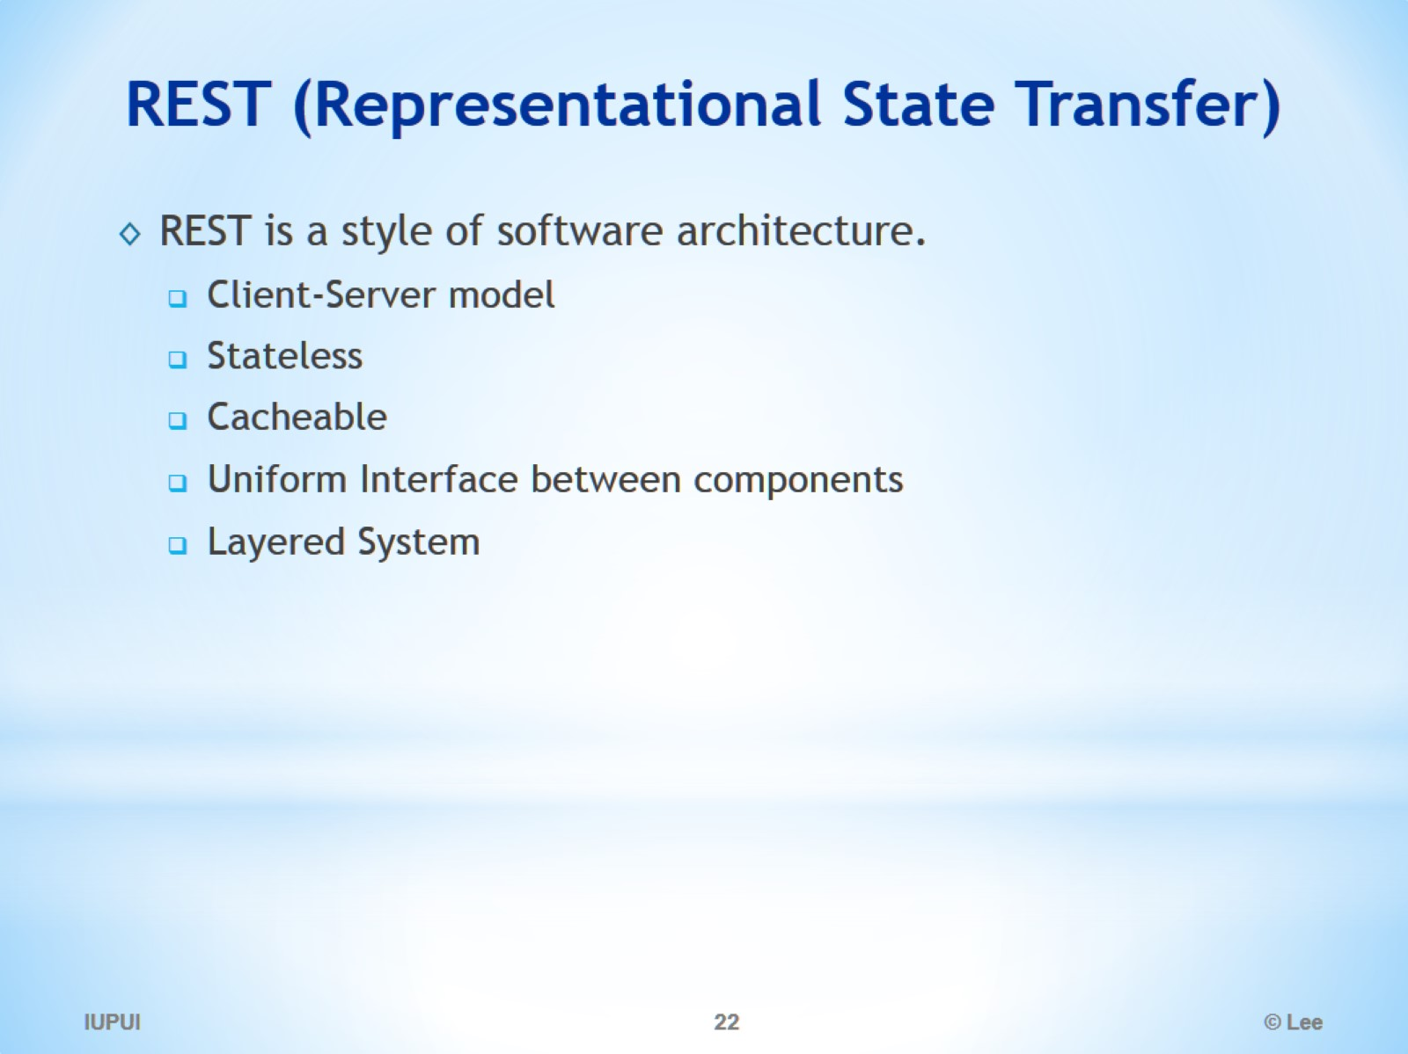
REST (Representational State Transfer)

Slide 23
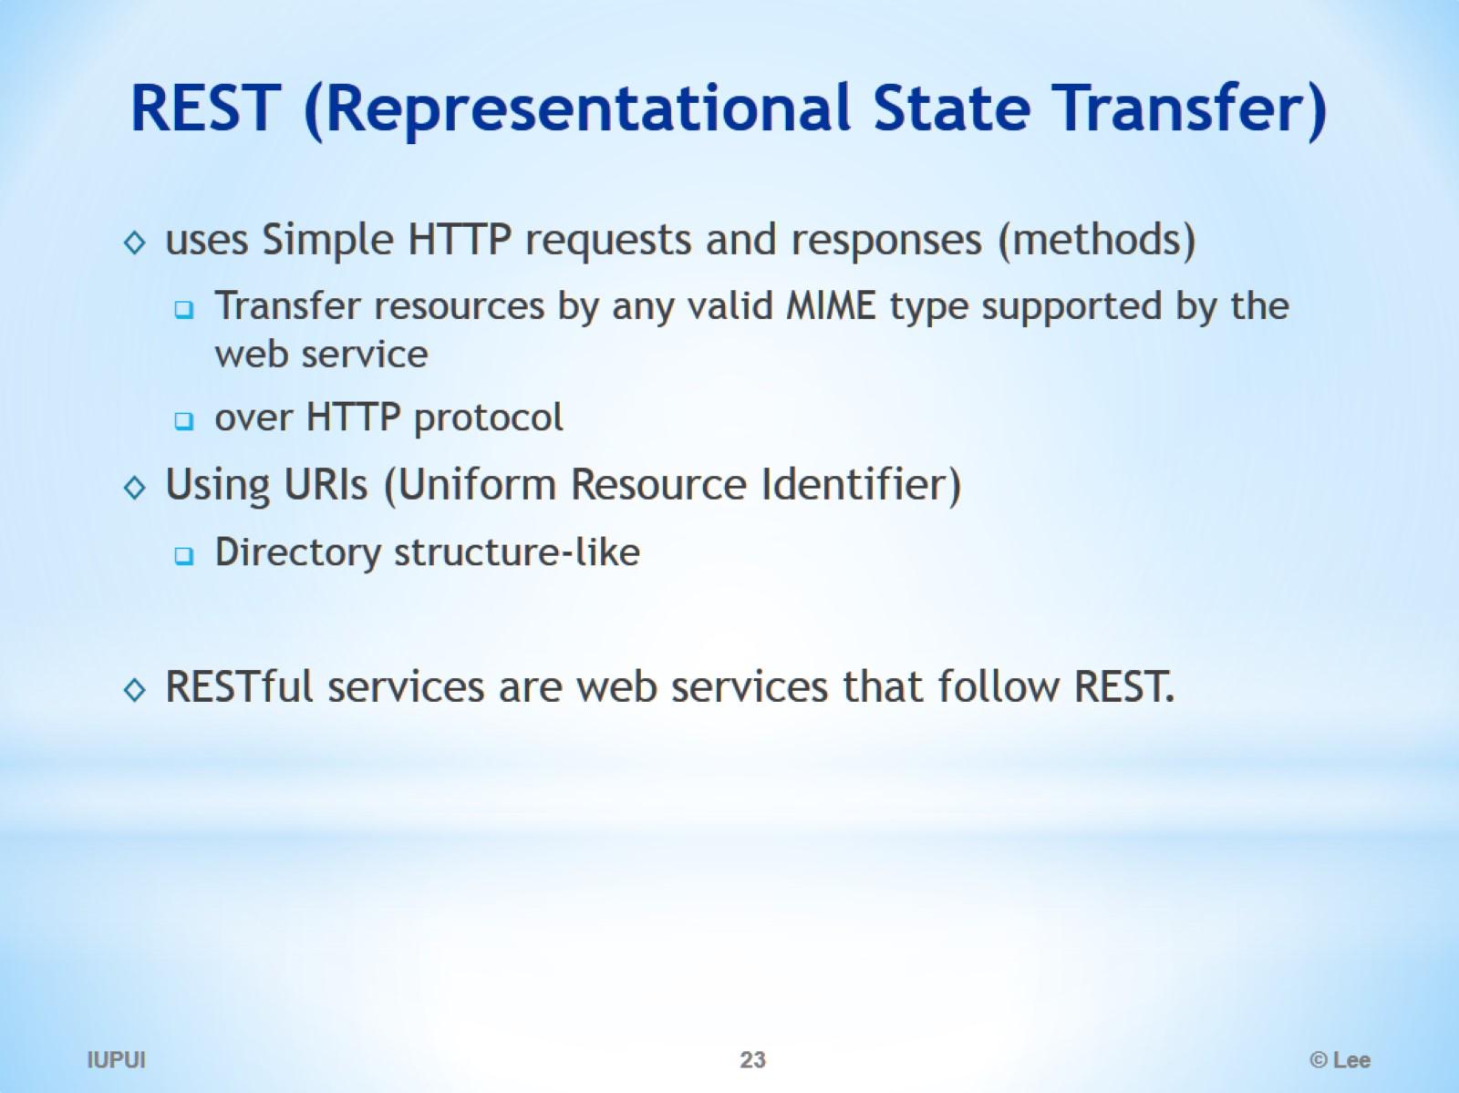
REST (Representational State Transfer)

Slide 24
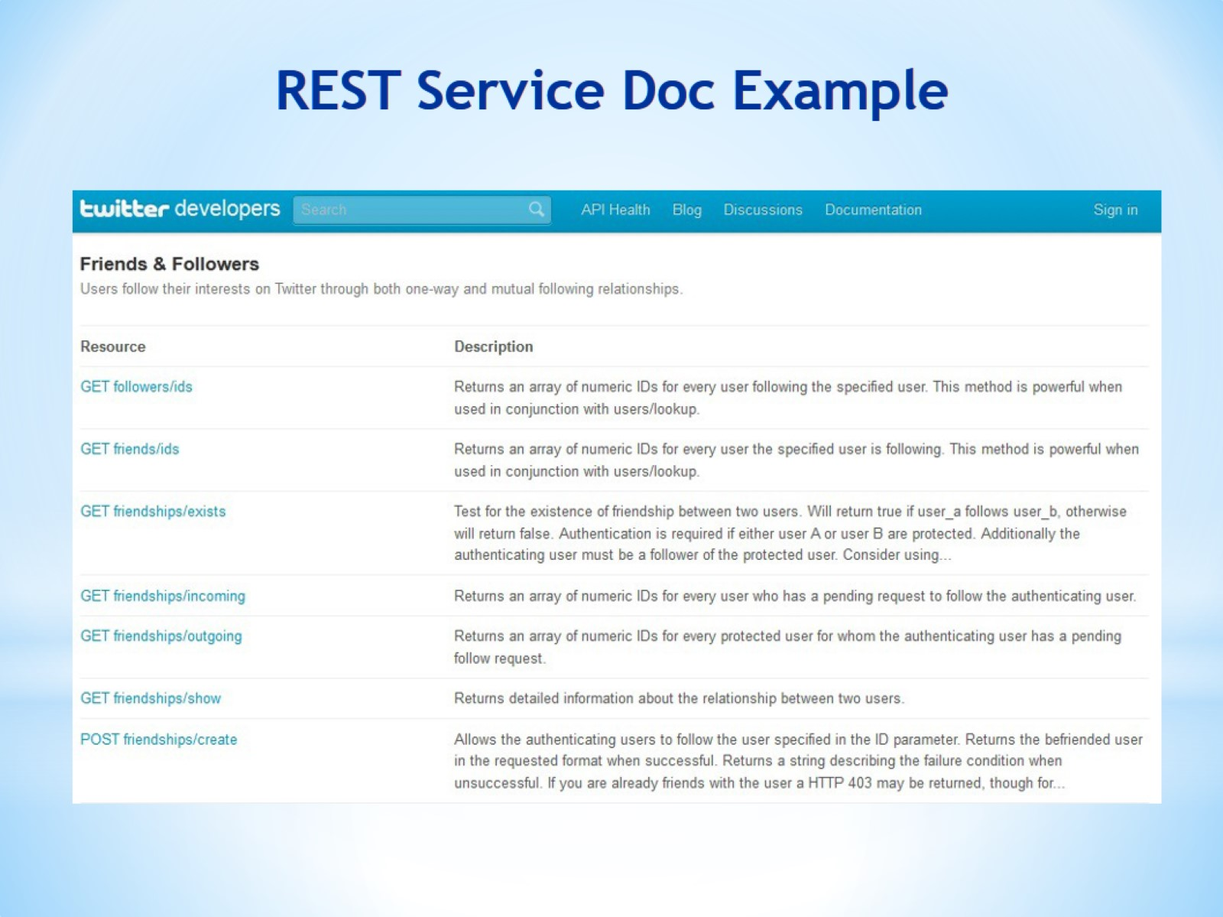
REST Service Doc Example

Slide 25
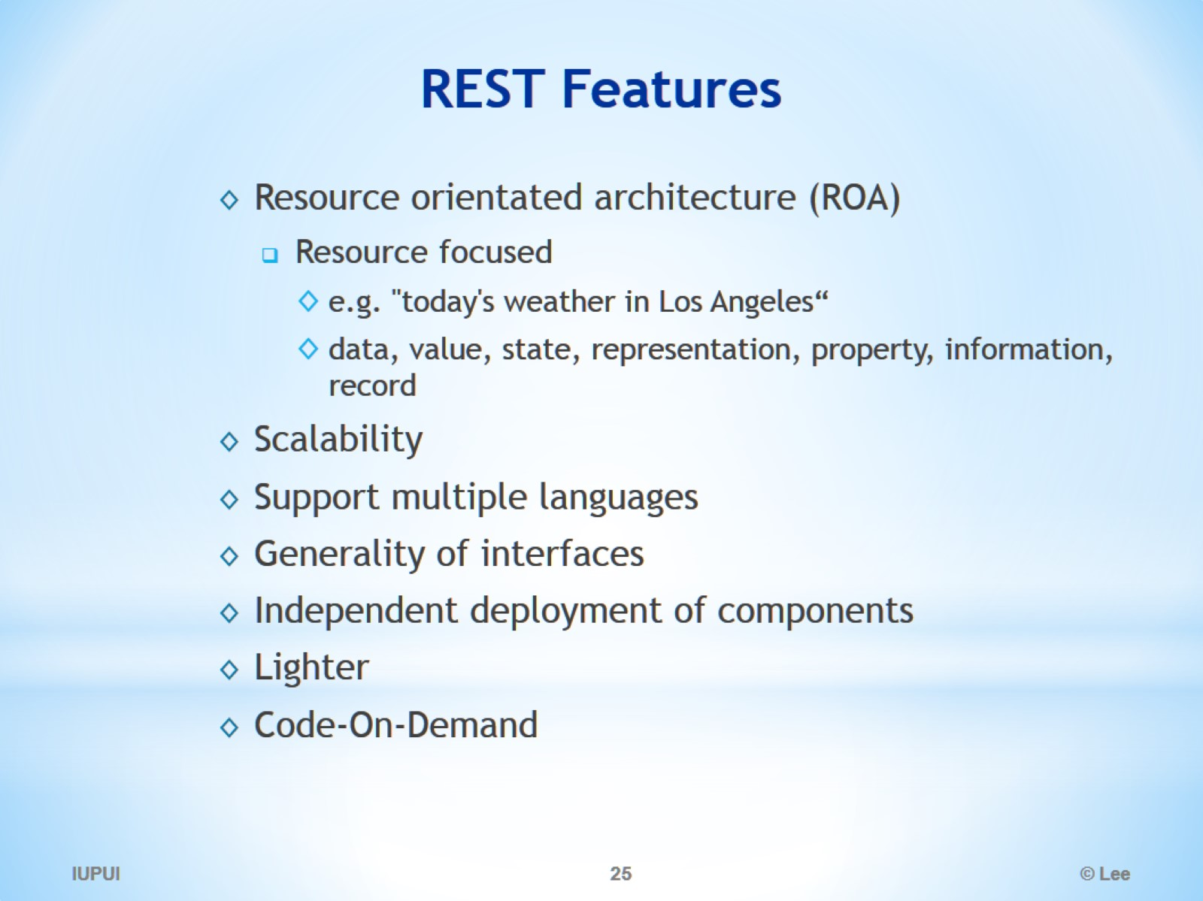
REST Features

Slide 26
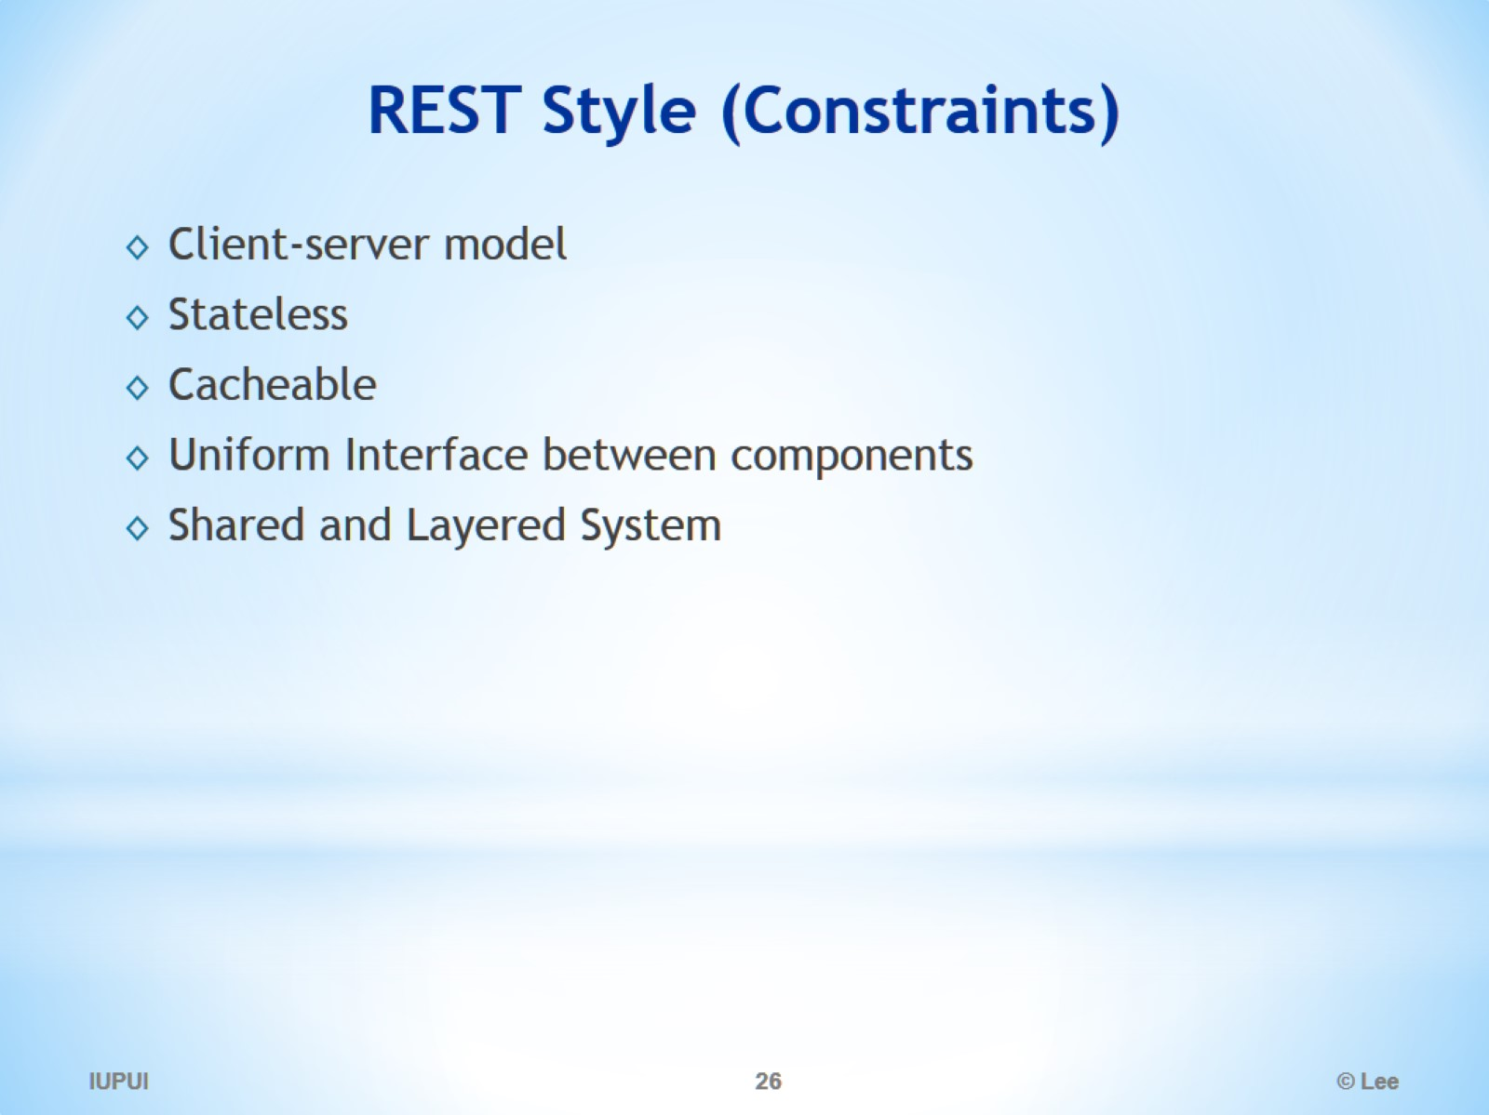
REST Style (Constraints)

Slide 27
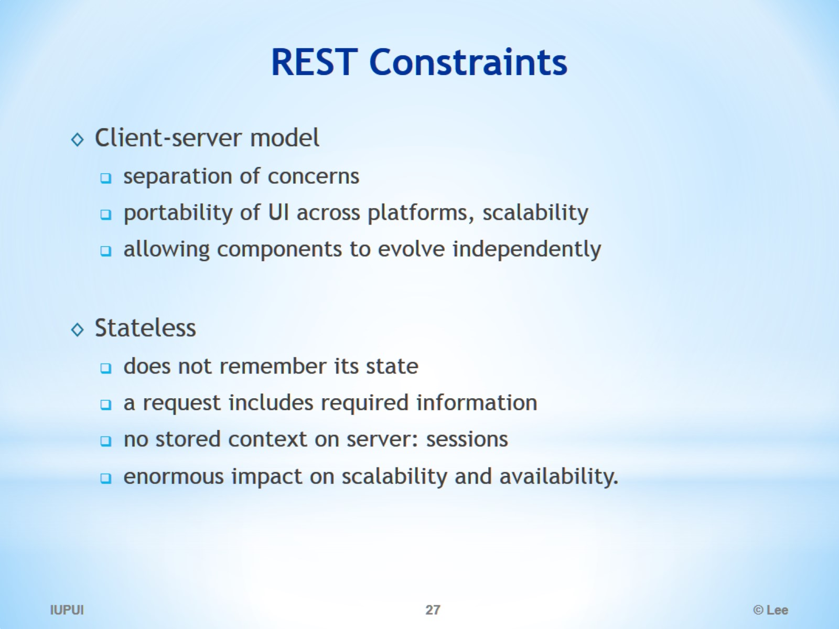
REST Constraints

Slide 28
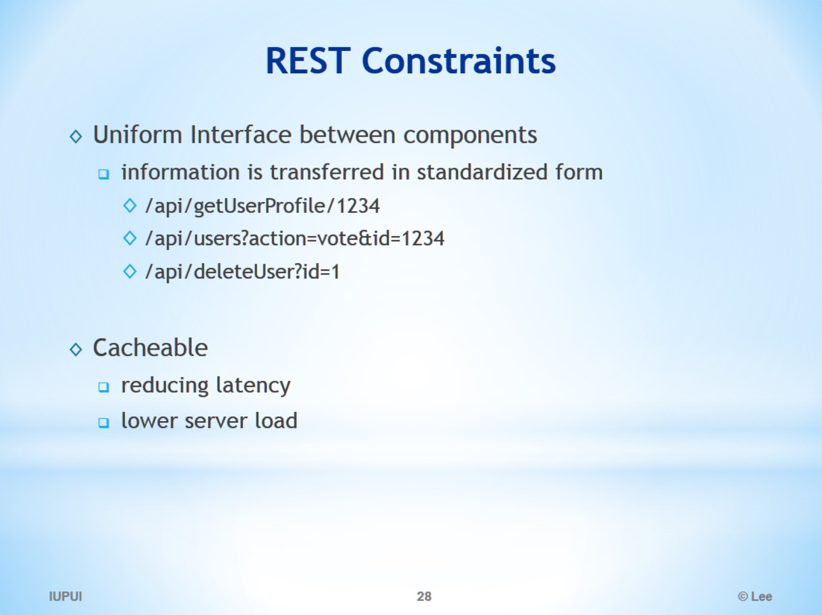
REST Constraints

Slide 29
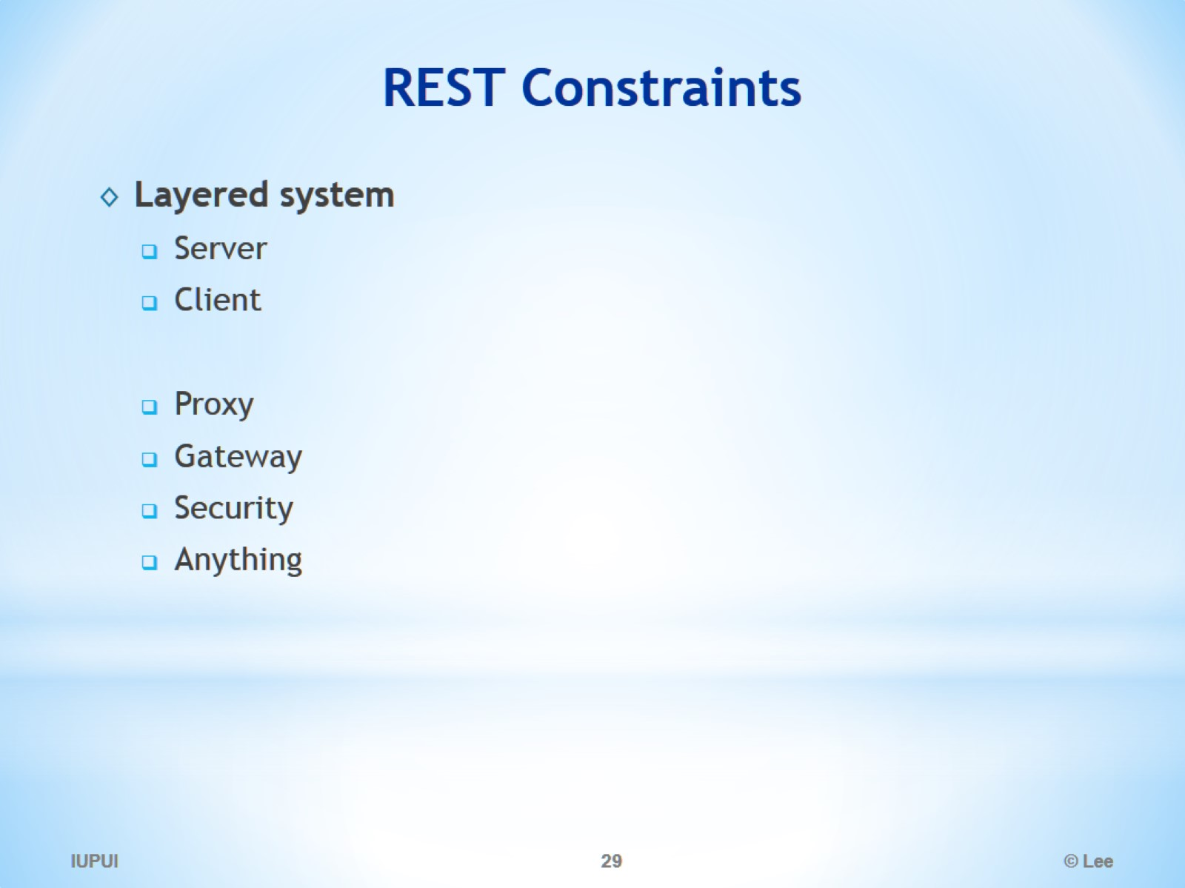
REST Constraints

Slide 30
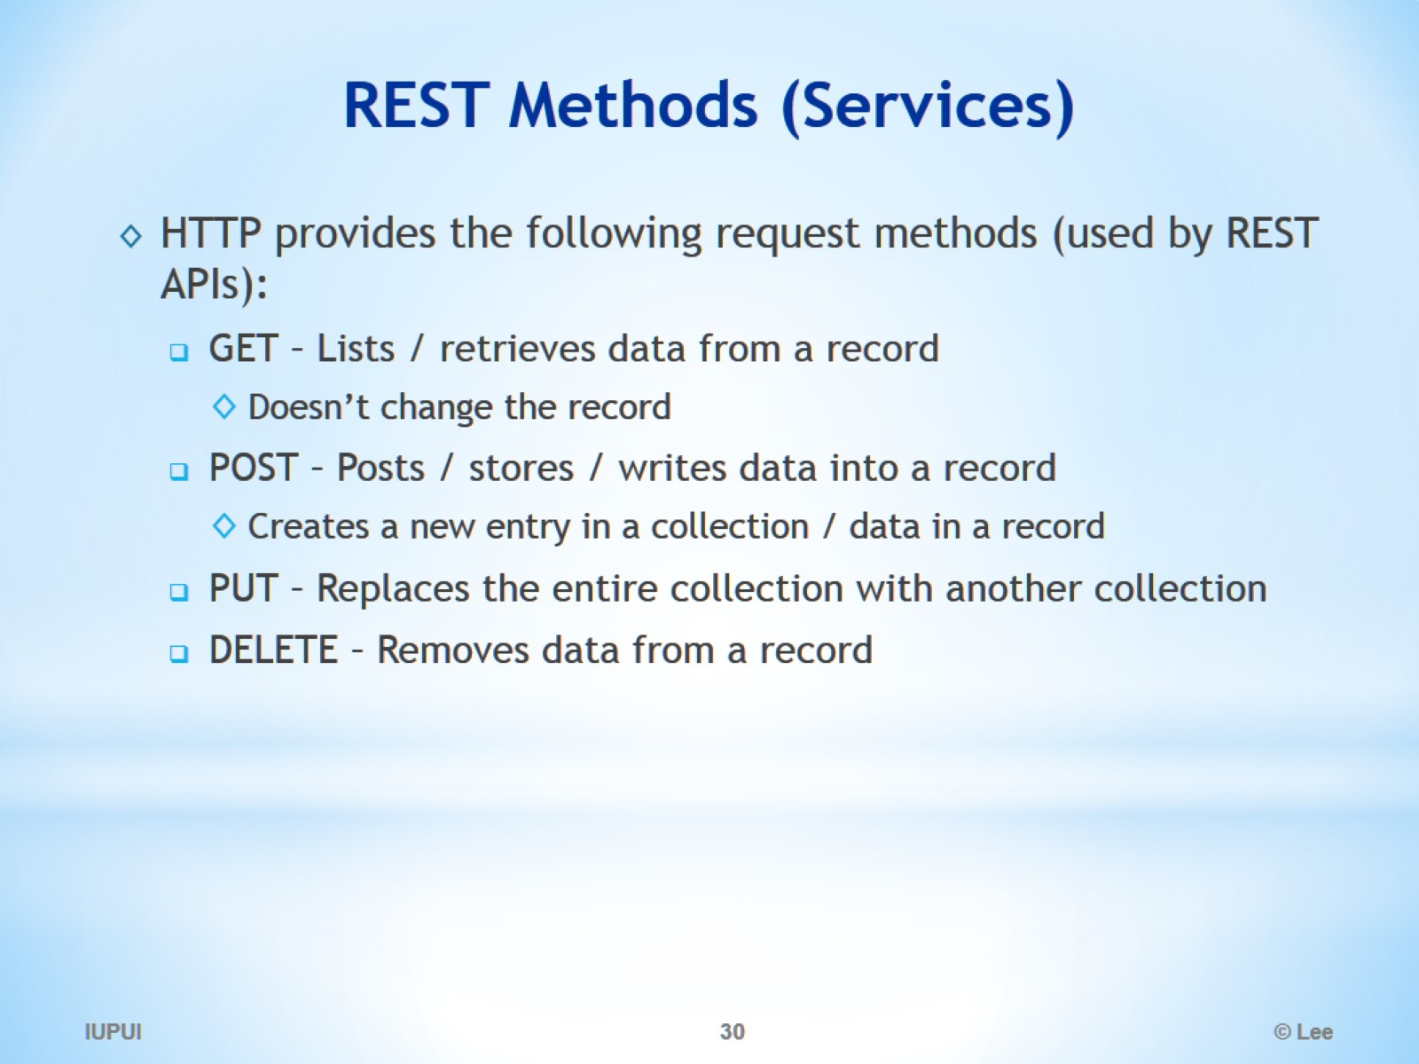
REST Methods (Services)

Slide 31
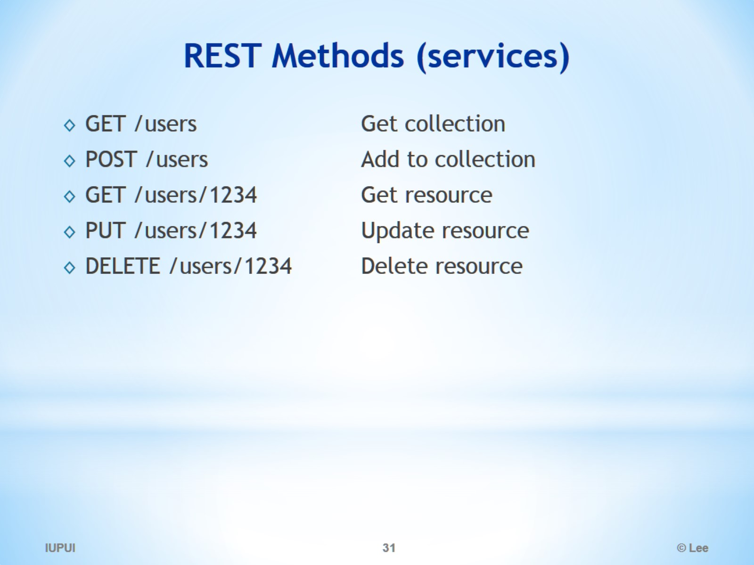
REST Methods (services)

Slide 32
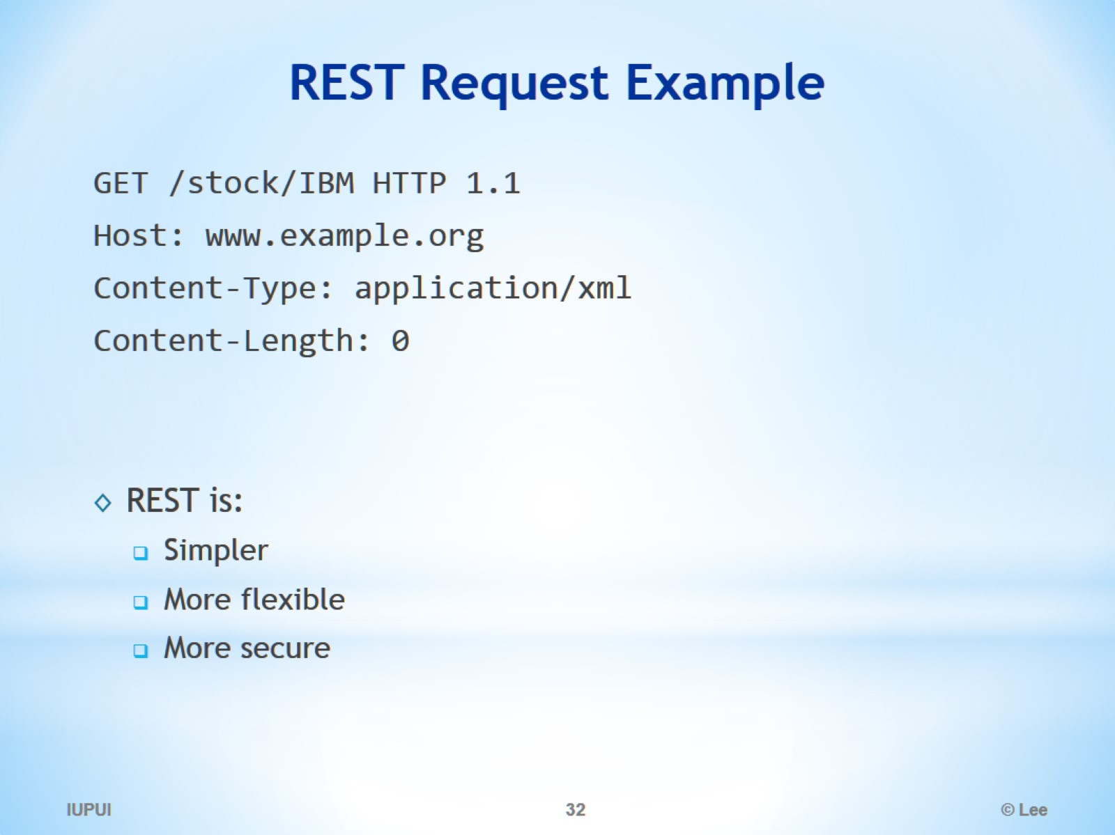
REST Request Example

Slide 33
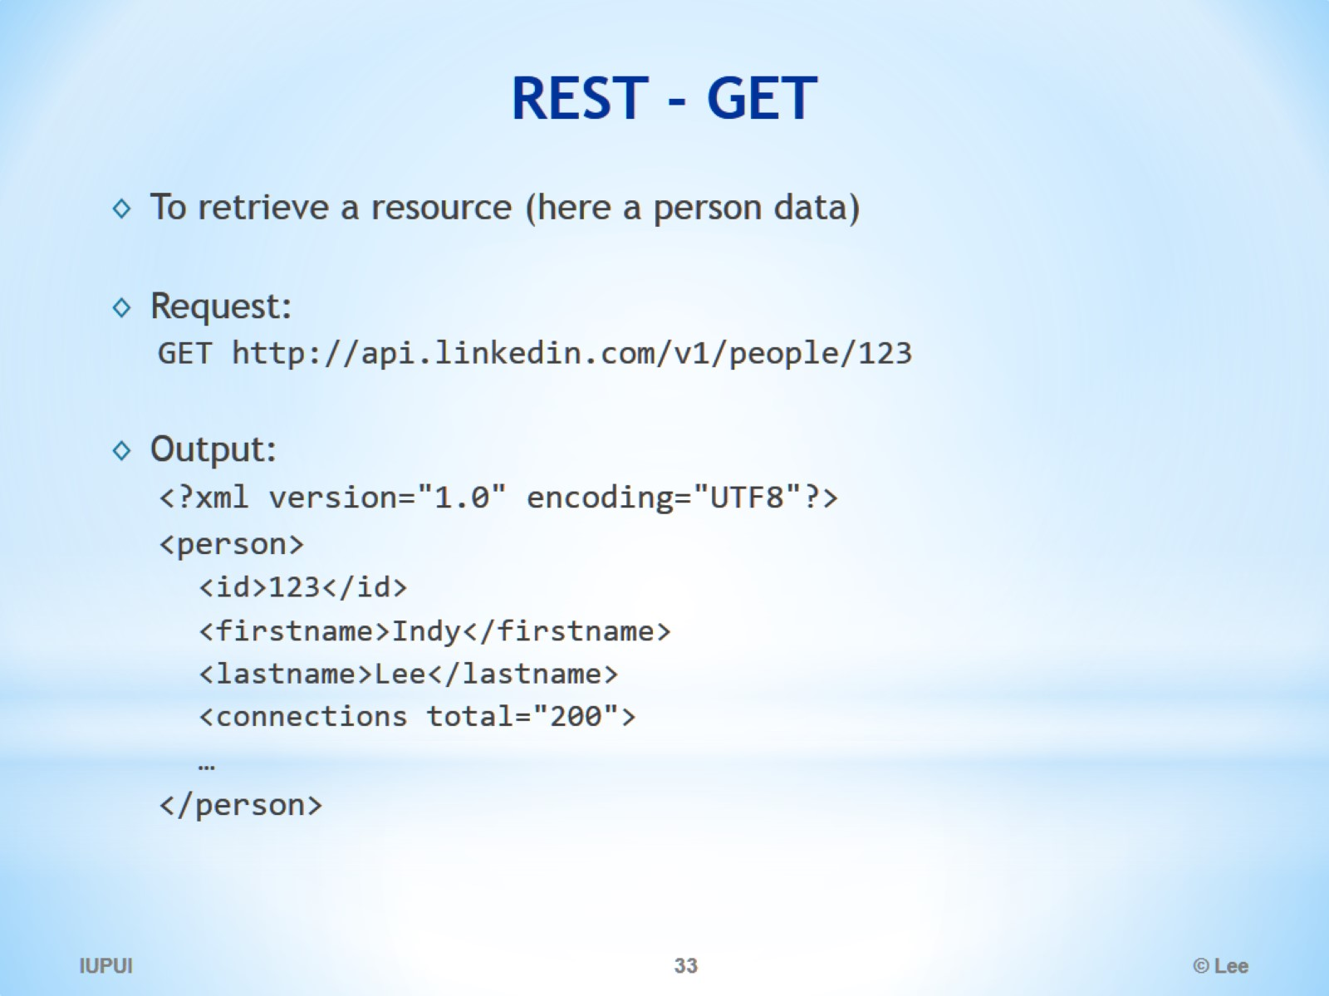
REST - GET

Slide 34
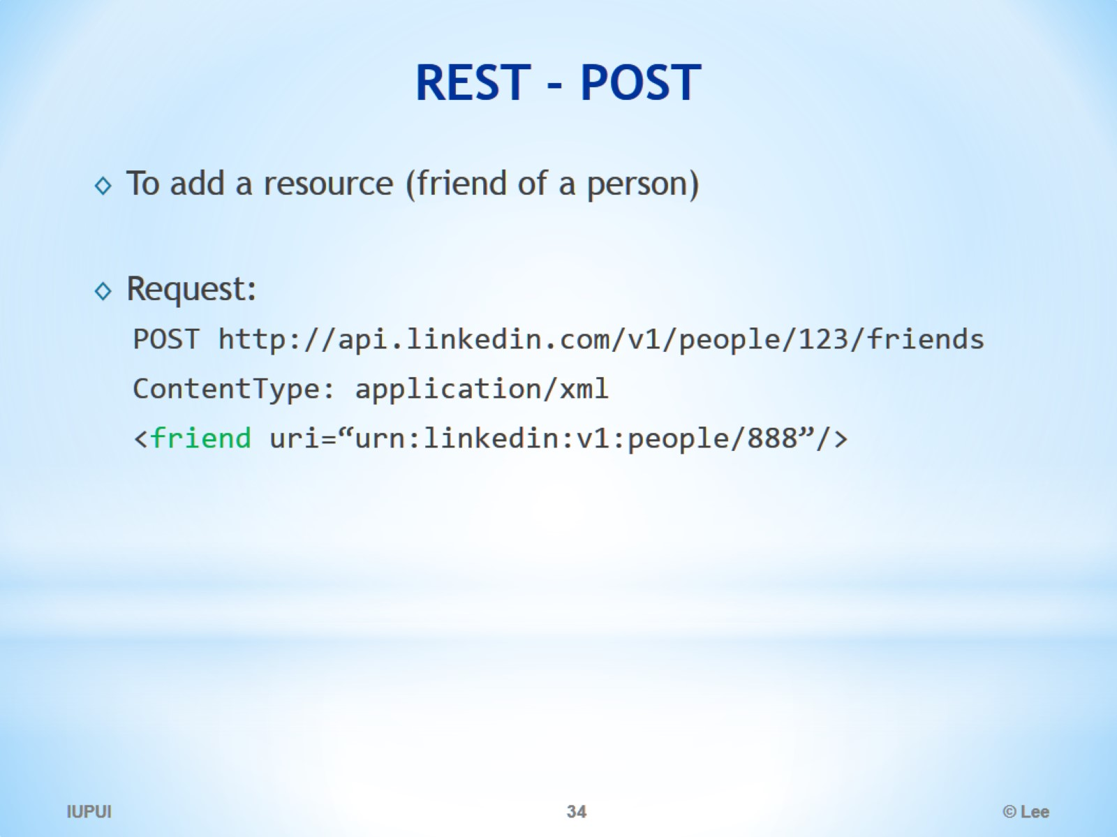
REST - POST

Slide 35
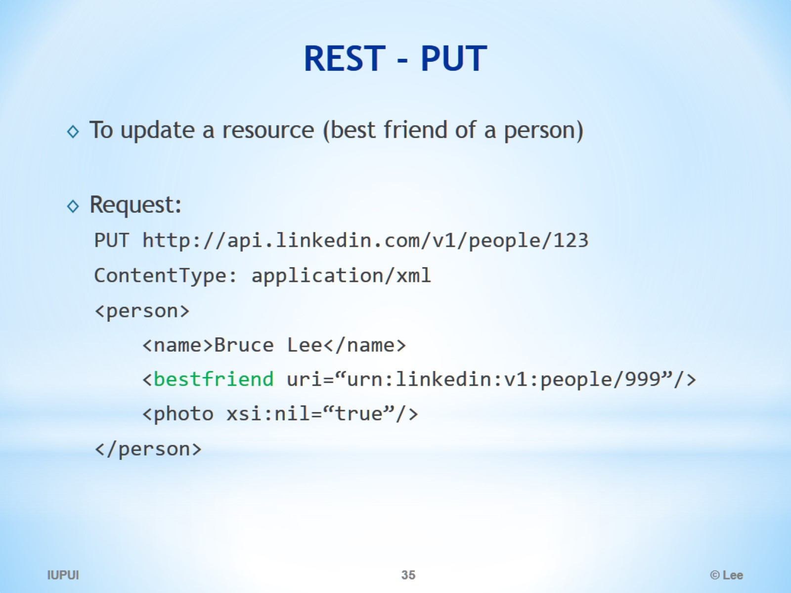
REST - PUT

Slide 36
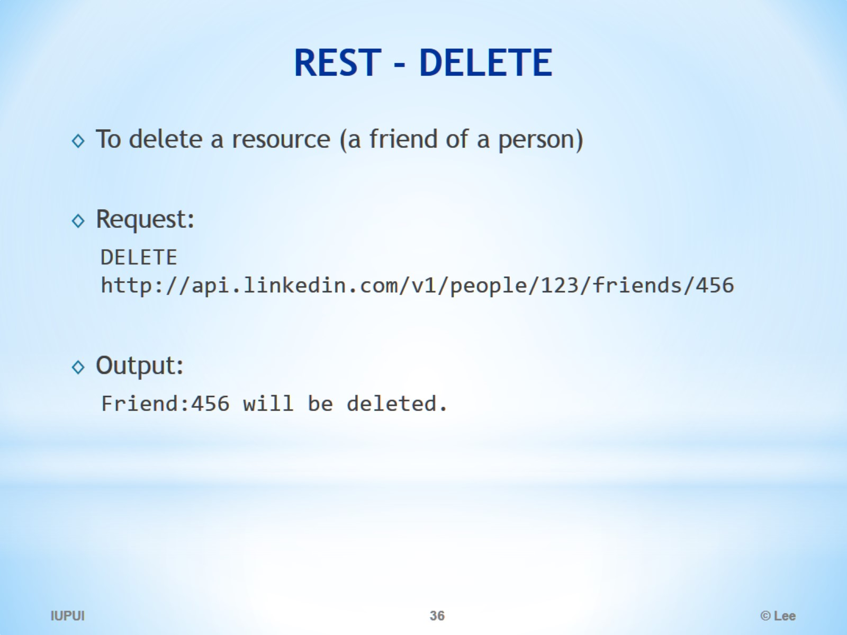
REST - DELETE

Slide 37
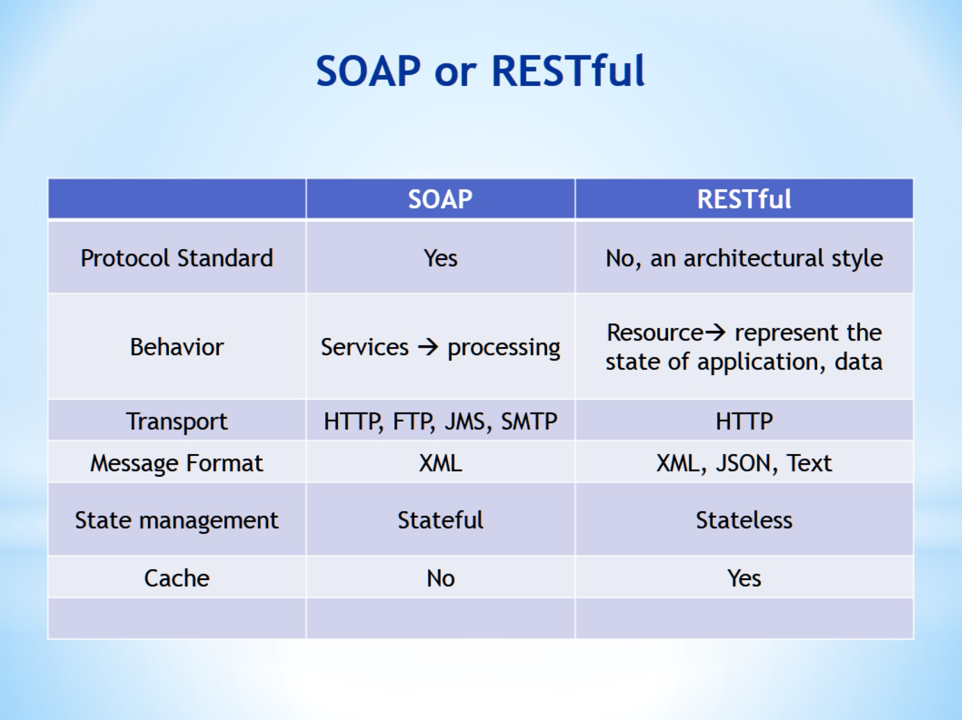
SOAP or RESTful

Slide 38
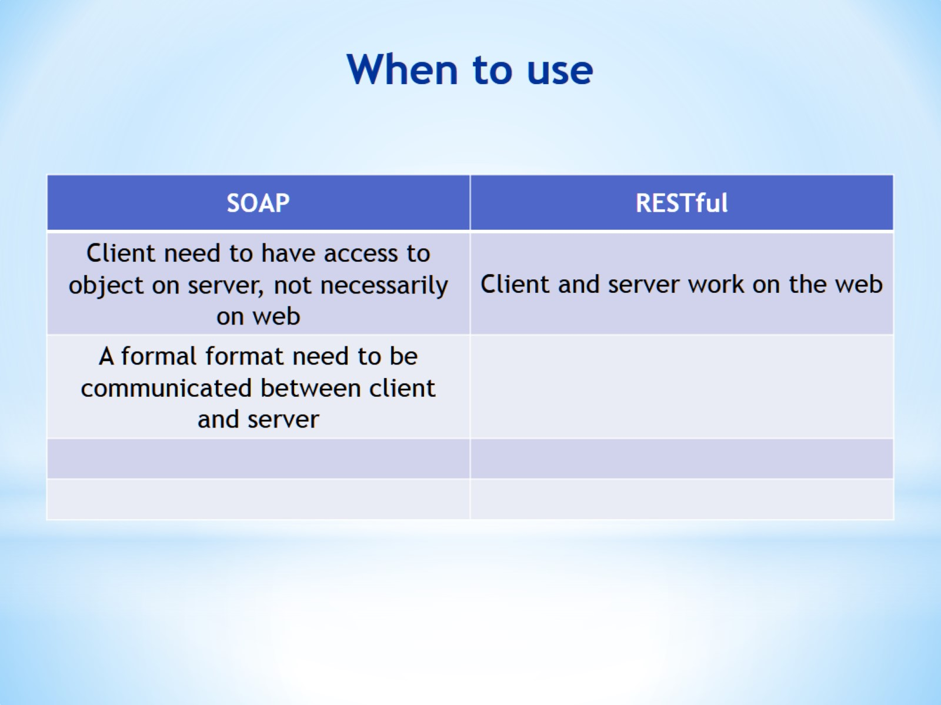
When to use

Slide 39
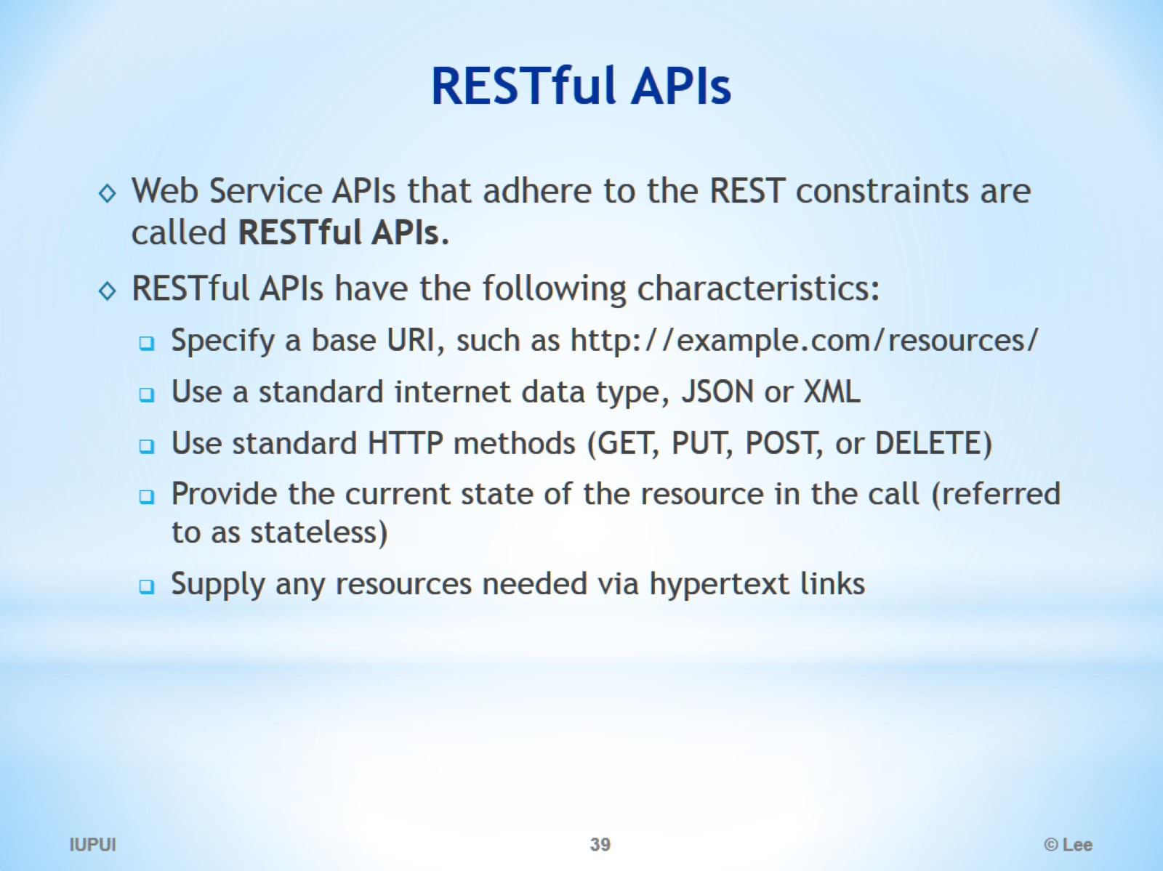
RESTful APIs

Slide 40
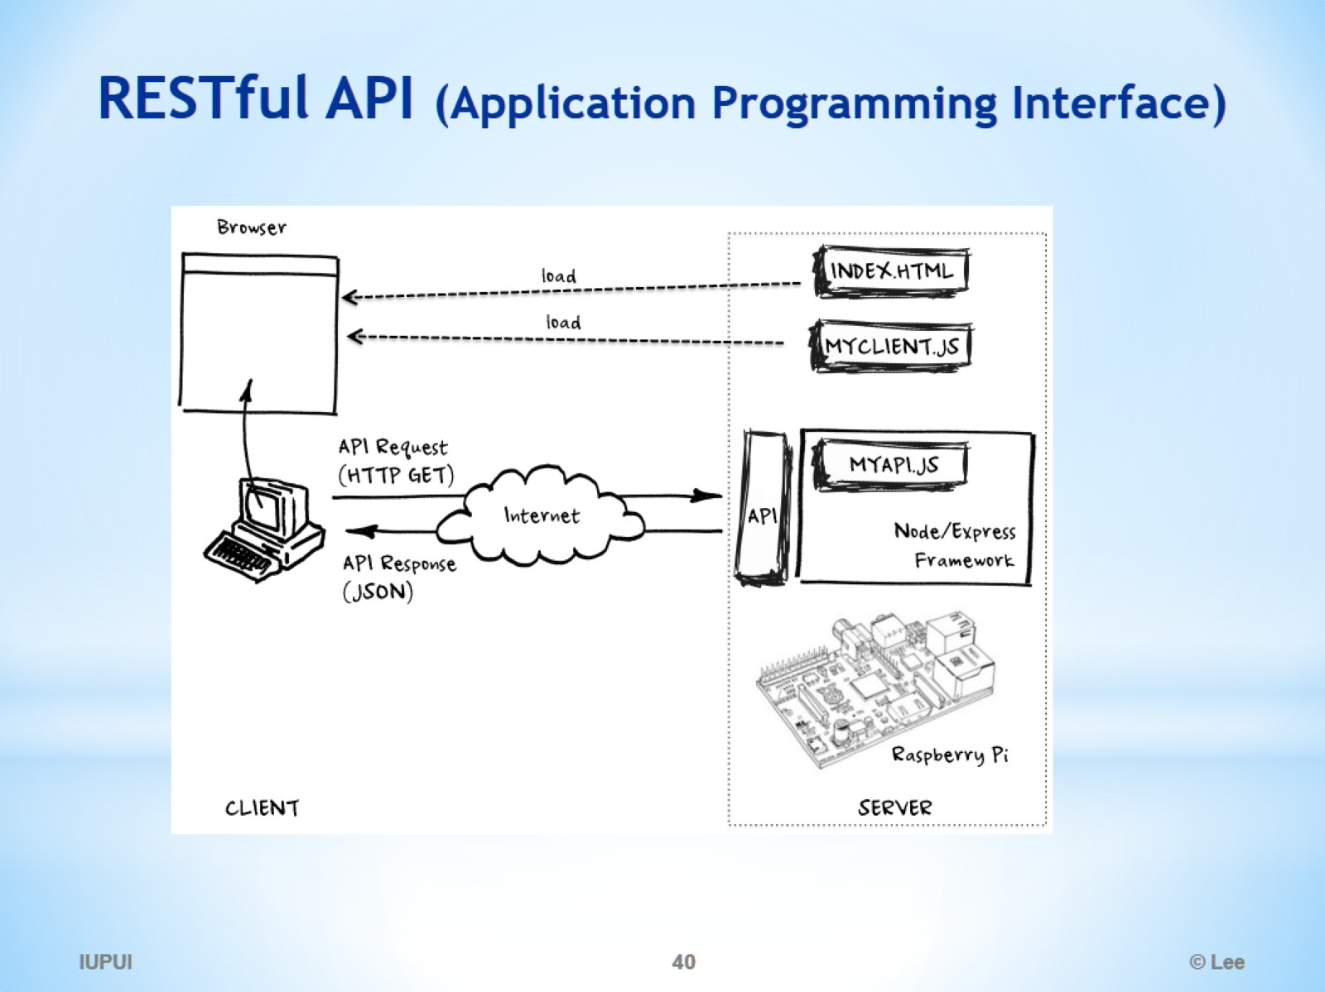
RESTful API (Application Programming Interface)

Slide 41
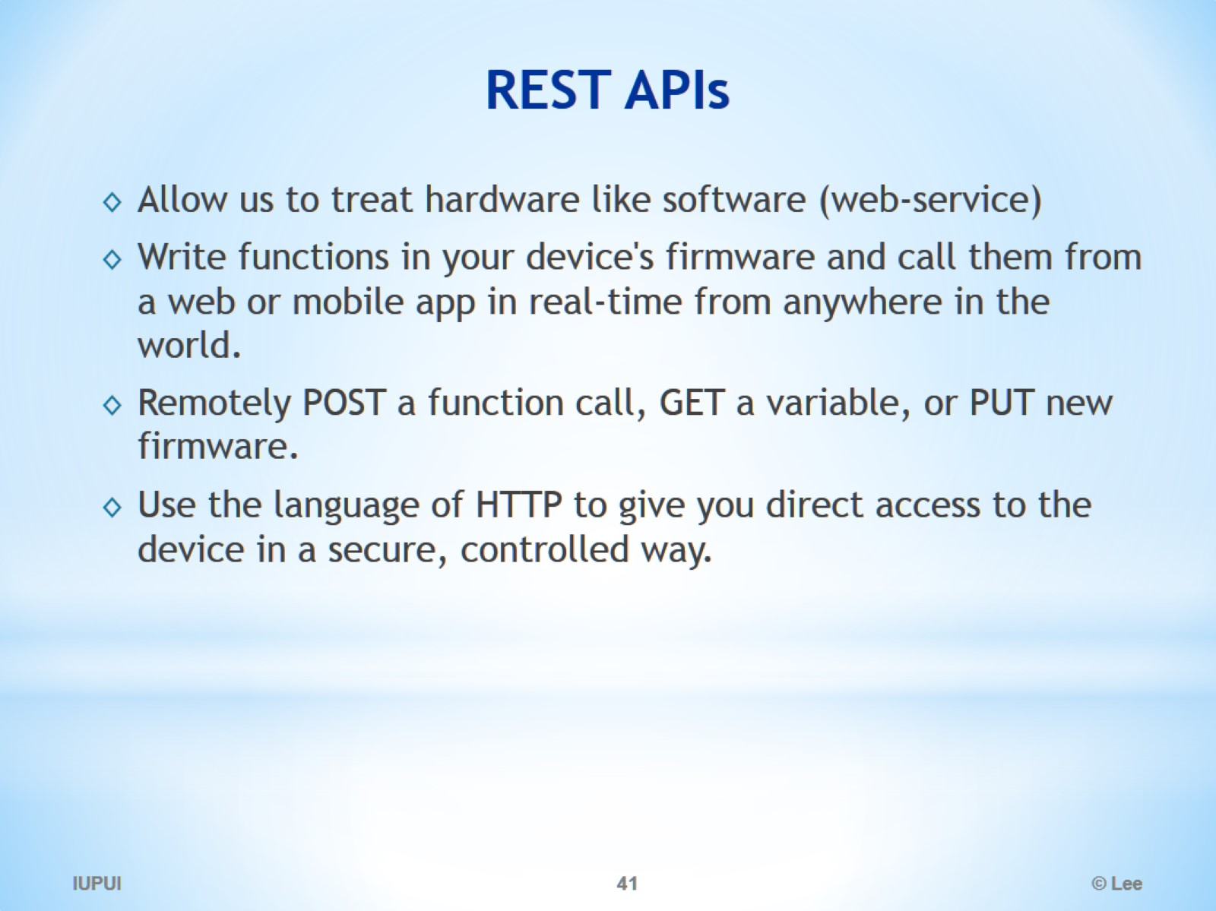
REST APIs

Slide 42
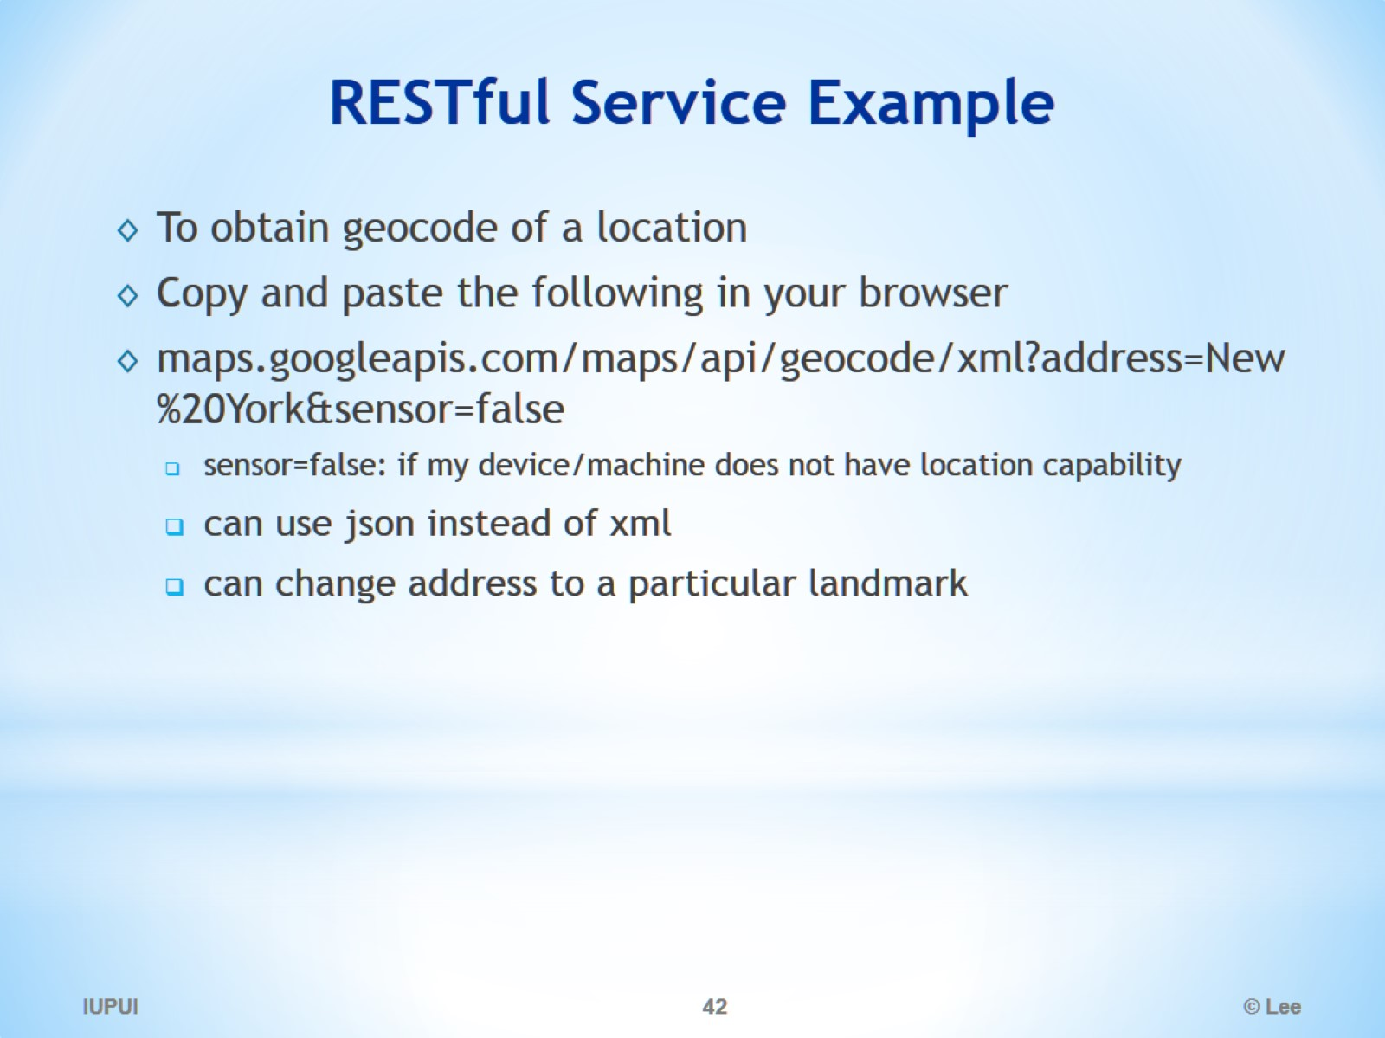
RESTful Service Example

Slide 43
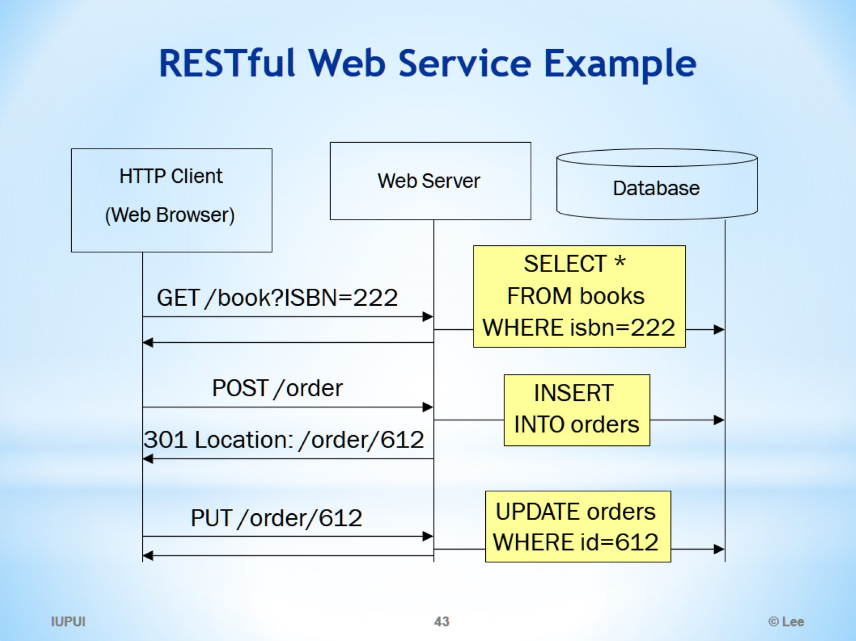
RESTful Web Service Example

